Slide 1
SCO Updates
SCO Conference 2019

Slide 2
Recent developments :
Design Build Delivery Methods (Design Build and Design Build w/ Bridging)
General Conditions : https://ncadmin.nc.gov/node/9027
Construction Contract documents : https://ncadmin.nc.gov/node/9026
Expanded INTERSCOPE:
Design Build Contracting
HUB reporting
Capital Project Coordinator Seminars:
Next scheduled : June 12th (Agencies & Universities); October 9th (Community Colleges)
Presentation available via Webinars
SCO Conference 2019

Slide 3
Recent developments :
Fully engaged in the electronic conversion
Still accept both hardcopies and electronic media
Field inspections and Construction Administration will follow starting this year
Exempt projects:
Minor scope
No professional designer involved
Must create project in INTERSCOPE for inspections to take place.
SCO Conference 2019

Slide 4
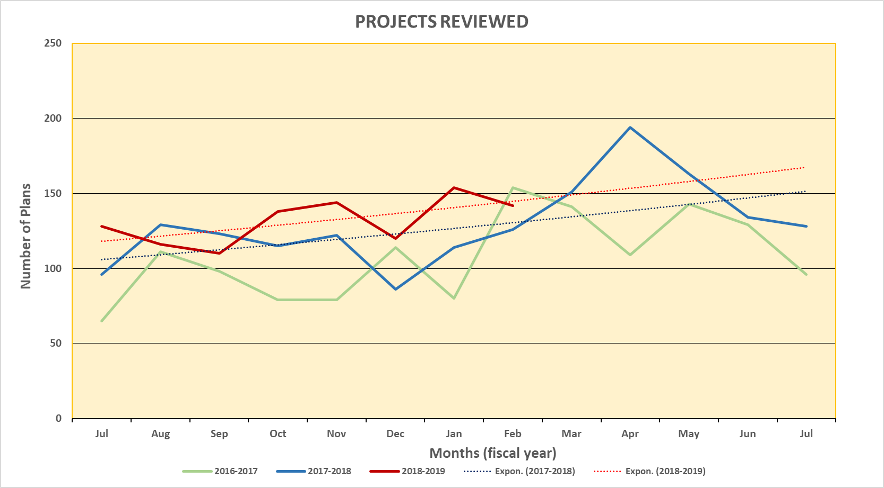
DESIGN review:
SCO Conference 2019

Slide 5
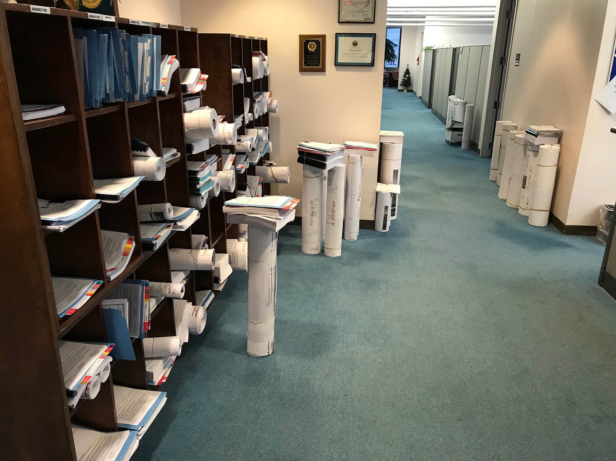
SCO Conference 2019

Slide 6
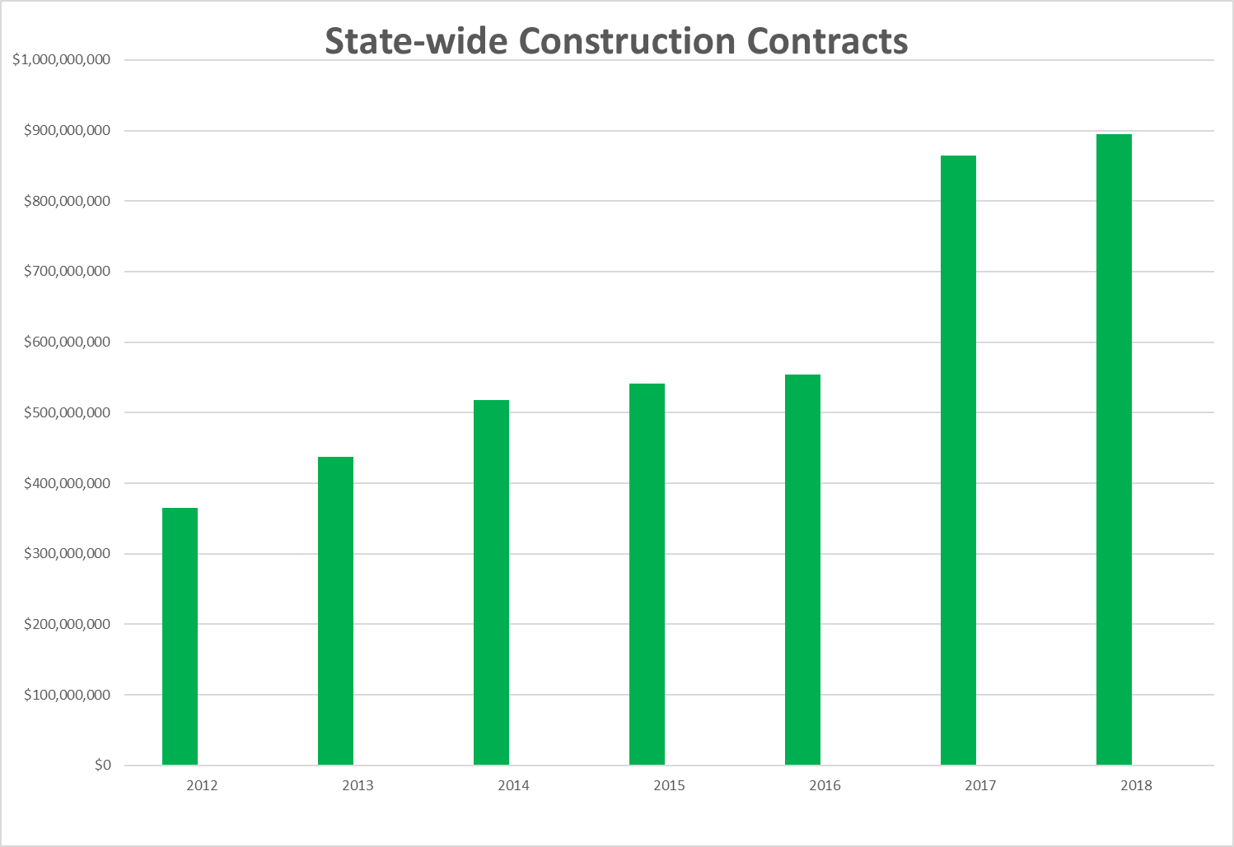
Construction Contracts:
SCO Conference 2019

Slide 7
FCAP current statistics
Facilities Condition Assessment Program
FCAP State-wide Cycle just Completed
All Counties complete.
118,253,785 square feet inspected
4489 buildings
10,402 deficiencies identified
Documented with estimates
$6.2 Billion in total deficiencies
All Priorities
Appropriated Funding ONLY

Slide 8
Deficiency Priority
1
Life Safety: Presence of a condition or absence of system which endangers health or life.
2
Critical: If not repaired, significant building damage will result.
3
ADA: buildings still not in compliance with the 1990 Act.
Targeted Renovation: Major renovation due to age or condition
4

Slide 9
Deficiencies by Priority
1
Life Safety: $691,292,300
2
Critical: $1,204,988,500
3
ADA: $120,167,500
Targeted Renovation: $4,174,598,878
4

Slide 10
FCAP current statistics
Consulting Section
FCAP State-wide Cycle just Completed
All Counties complete.
118,253,785 square feet inspected
4489 buildings
10,402 deficiencies identified
Documented with estimates
$6.2 Billion in total deficiencies
All Priorities
Appropriated Funding ONLY

Slide 11
Consulting Services:
Responsibilities
Architecture & Engineering for DOA
Assist DOA’s Facility Management and State Property
Work with Building Coordinators on the Downtown Government complex concerning building system problems
Capital Project Management for DOA
Budget request
Designer interviews
Provide owner “coordination” comments
Prequalification criteria
Construction Administration
Electrical Inspections (Statewide)
Assist Plan Review
Inspections (5 electrical inspectors)
SCO Conference 2019

Slide 12
Work in Progress:
Workload across all platforms is very heavy.
Continue further development of INTERSCOPE and merging with the digital conversion of field inspections and construction administration.
Continue the development and implementation of the newest contract delivery methods: Design Build, Design Build w/ Bridging and Public Private Partnership.
Continue our involvement with the NC Building Code Council and the HUB Council in promoting outreach and increase participation.
SCO Conference 2019

Slide 13
Inspection DISCOVERIES
SCO Conference 2019

Slide 14
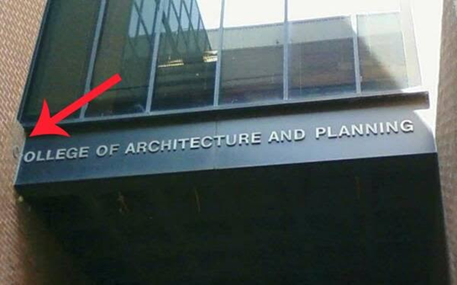
College of Architecture and Planning
SCO Conference 2019

Slide 15
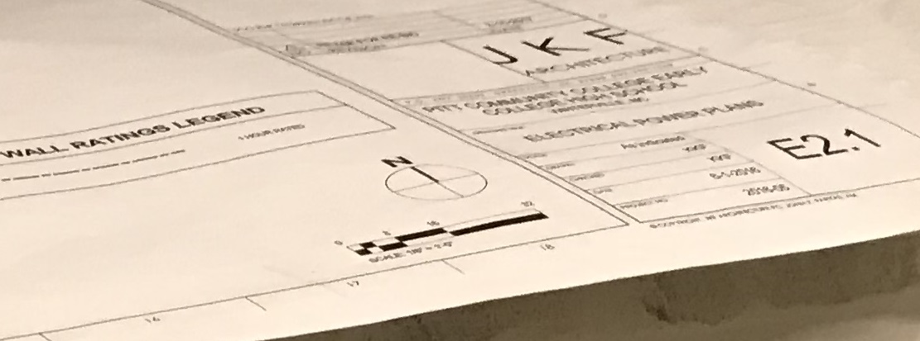
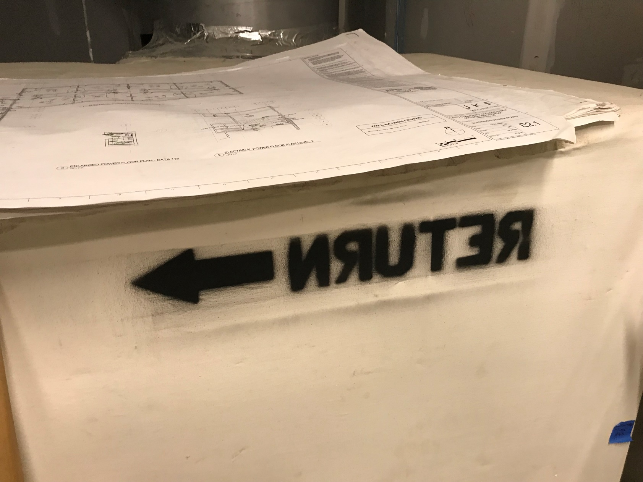
The stencil was wrong
SCO Conference 2019

Slide 16
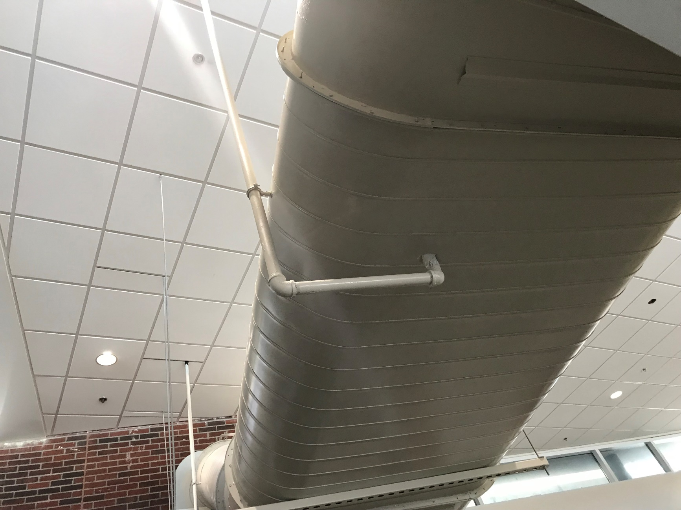
Better than painted head
SCO Conference 2019

Slide 17
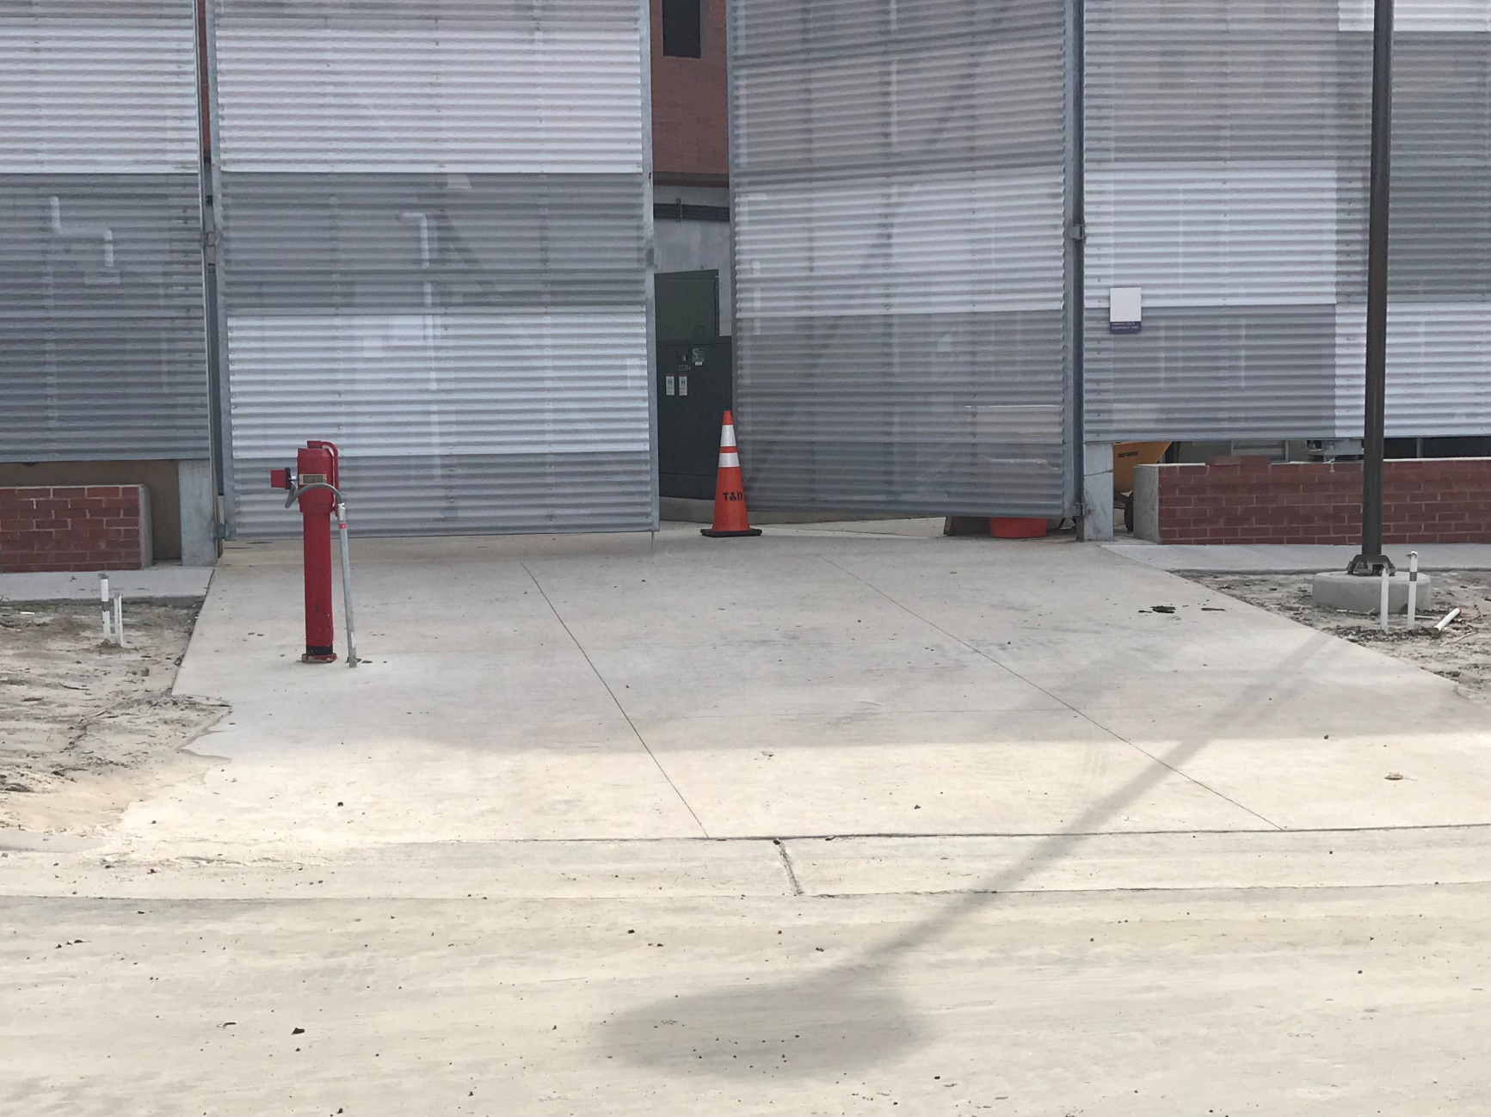
It is out of the way
SCO Conference 2019

Slide 18
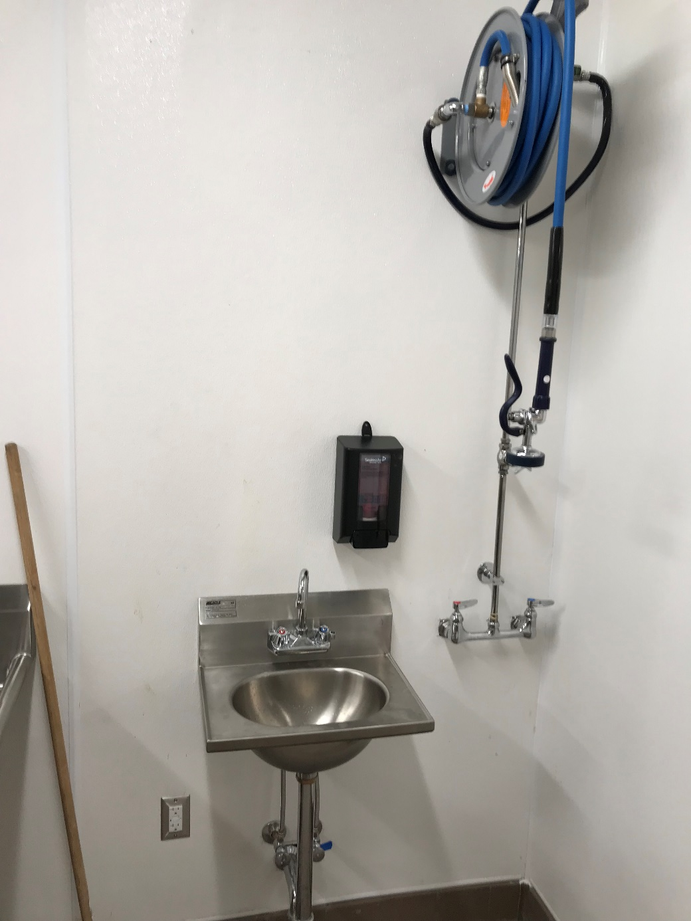
Too close for comfort
SCO Conference 2019

Slide 19
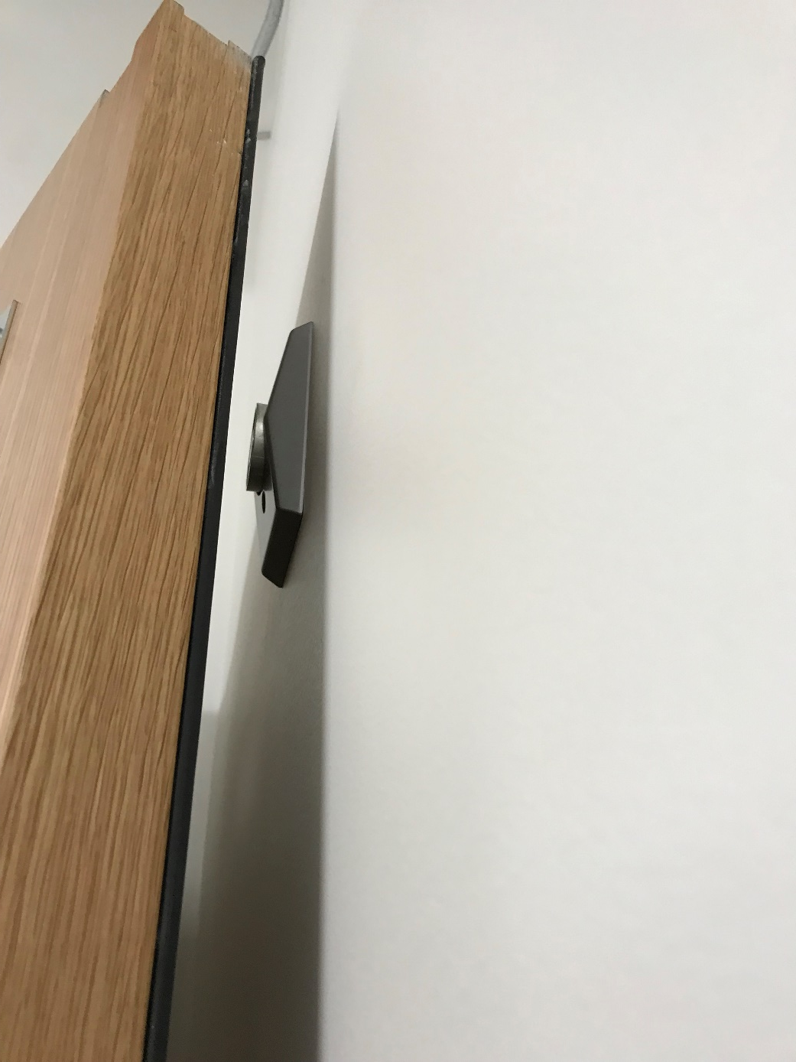
Almost, does not get it
SCO Conference 2019

Slide 20
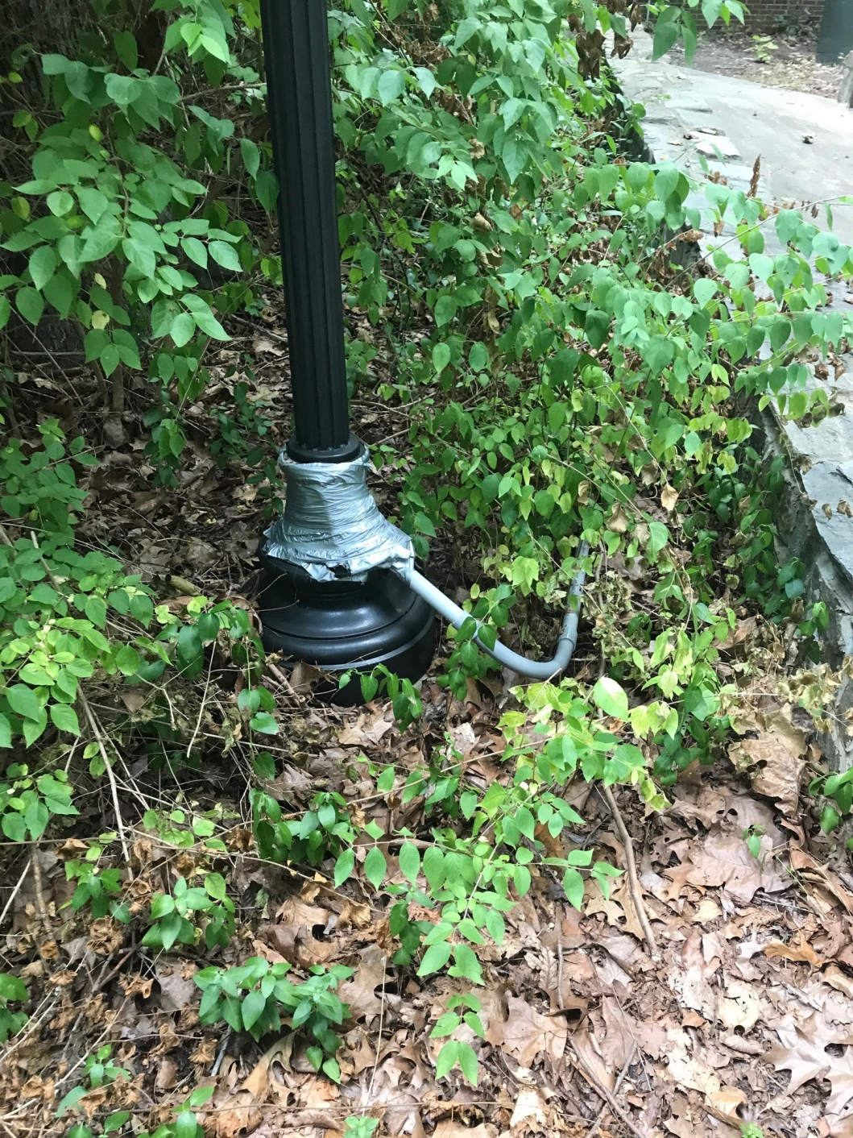
If it can’t be fix, duct tape will
SCO Conference 2019

Slide 21
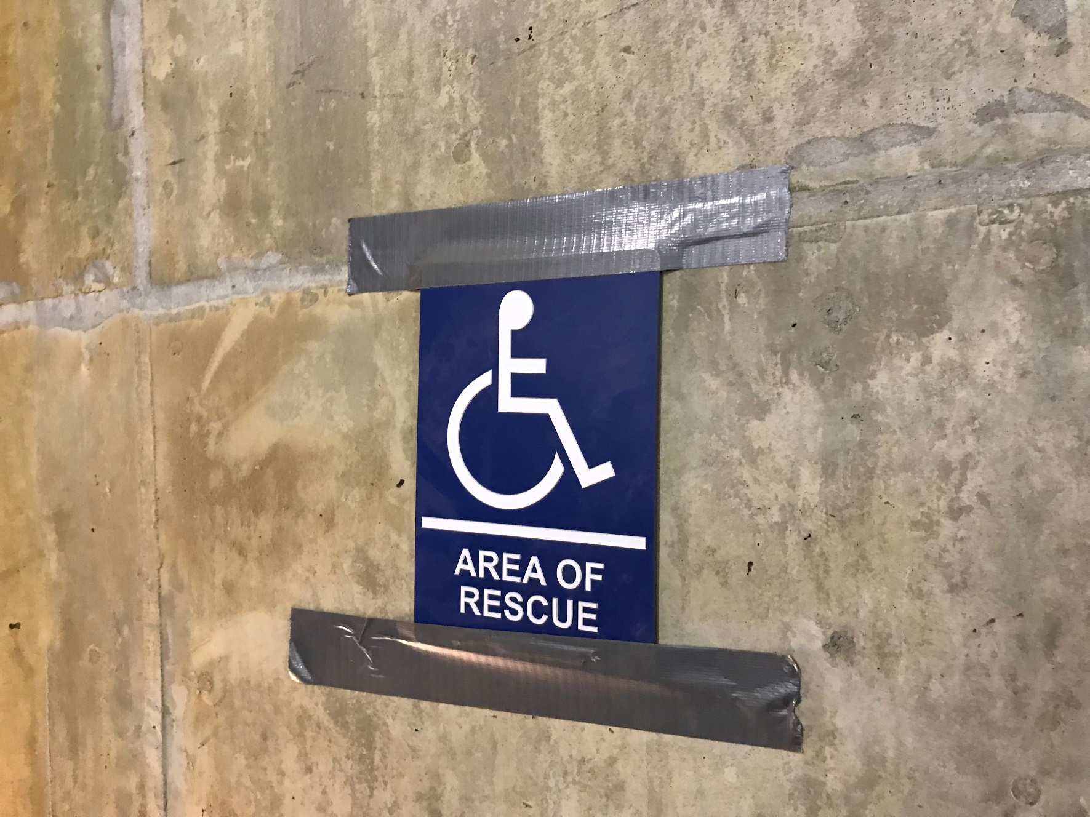
Another great use of duct tape
SCO Conference 2019

Slide 22
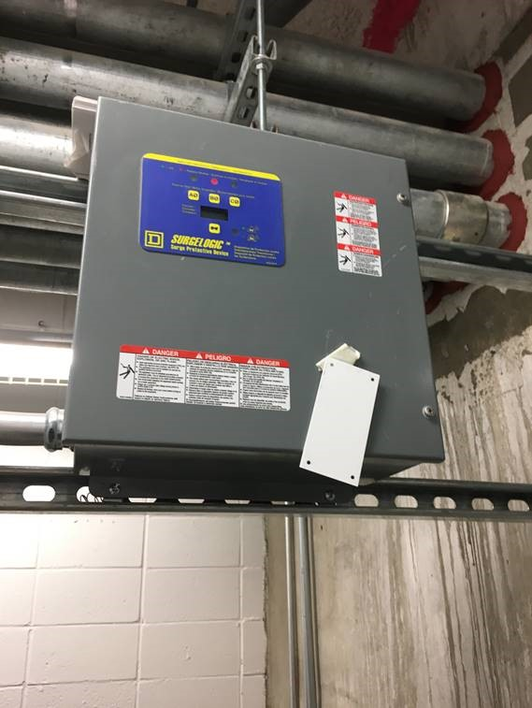
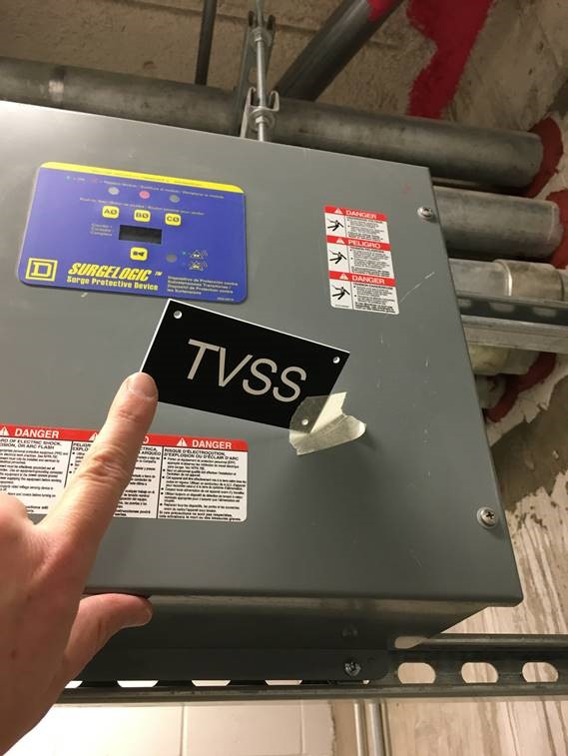
Paper tape is not better
SCO Conference 2019

Slide 23
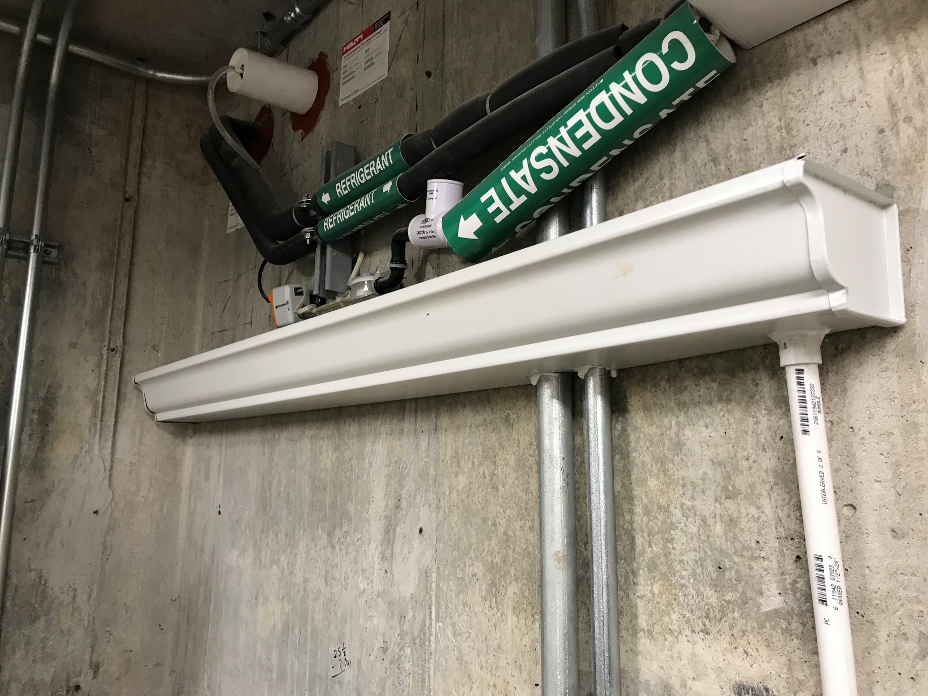
Gutters that work
SCO Conference 2019

Slide 24
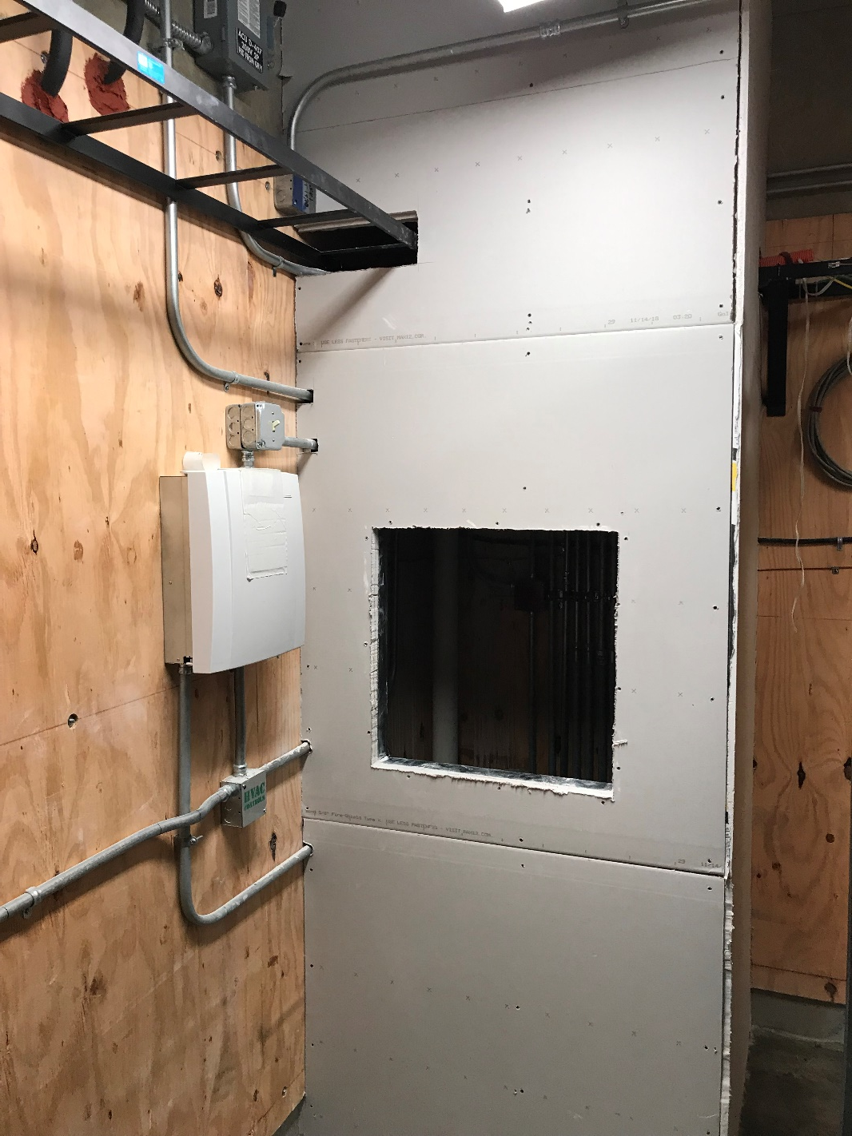
The mystery corner
SCO Conference 2019

Slide 25
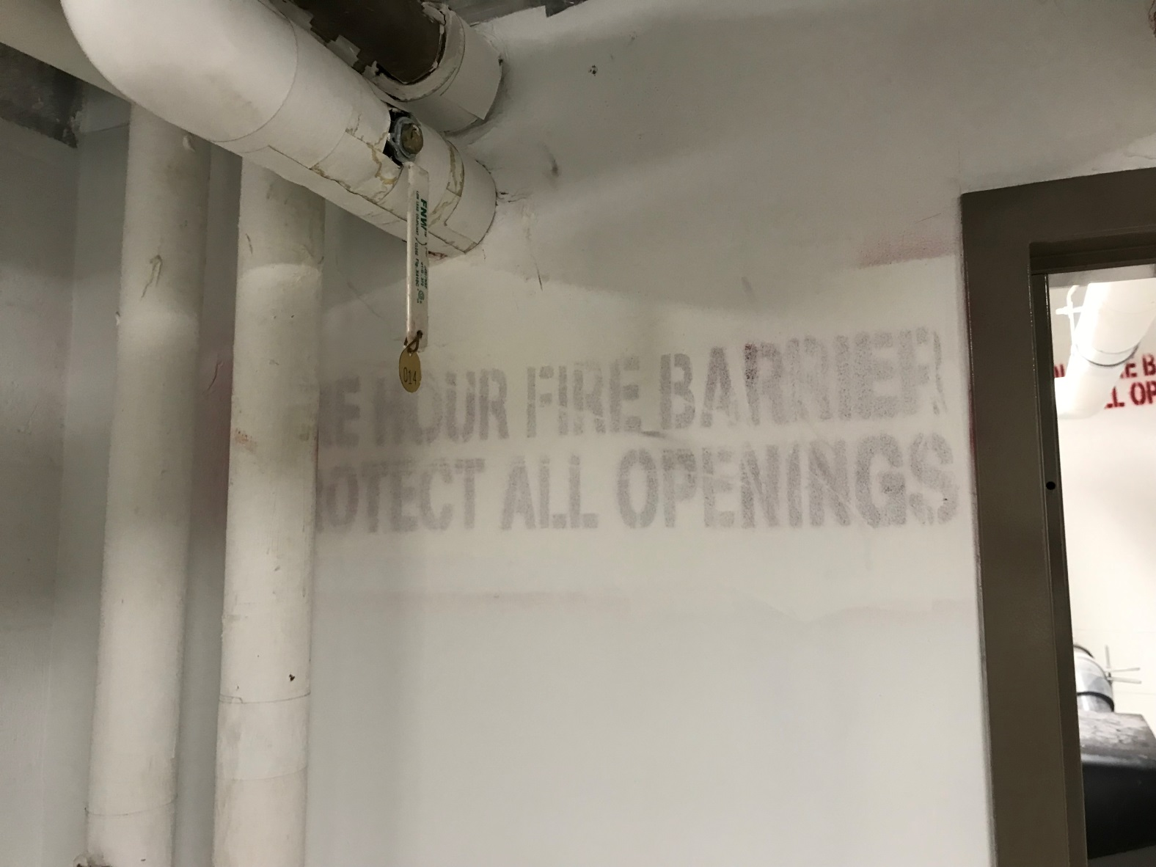
Give me a hint, is it rated or not?
SCO Conference 2019

Slide 26
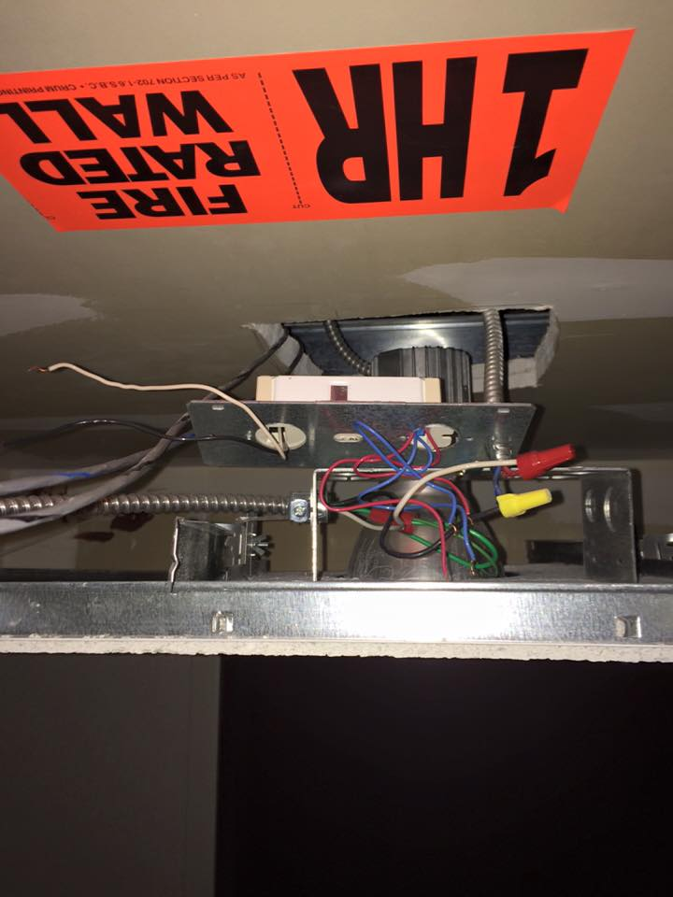
Is this wall rated?
SCO Conference 2019

Slide 27
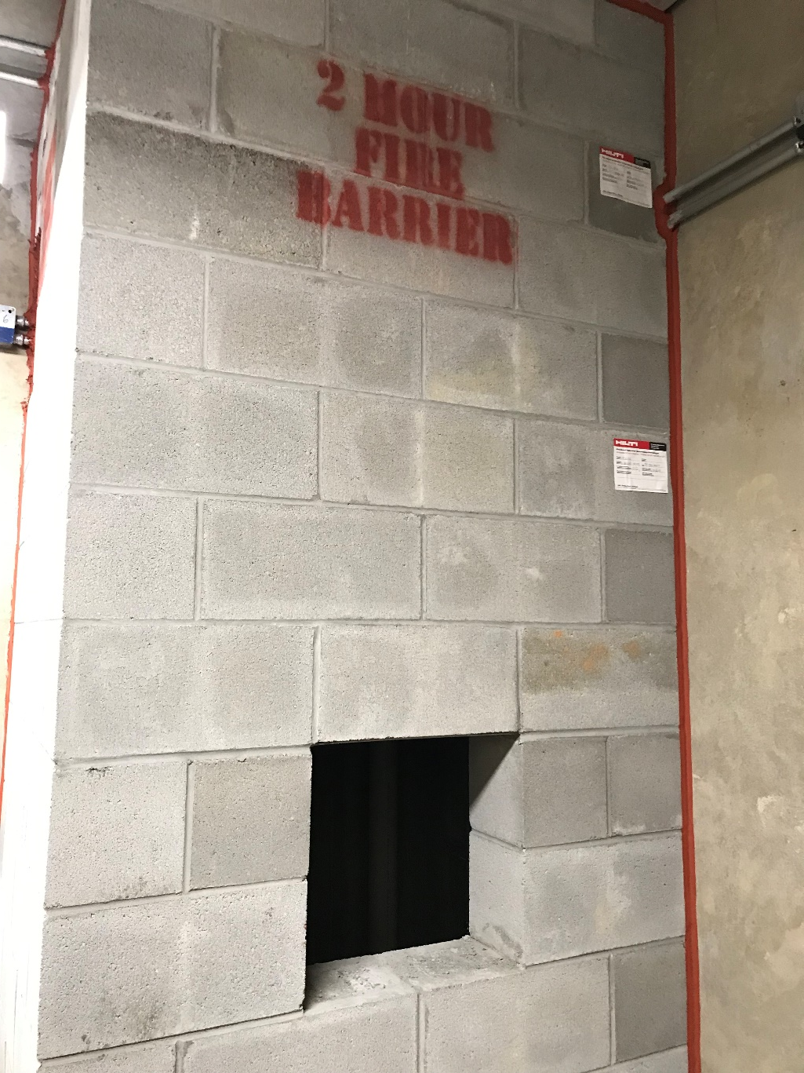
How about this one? I don’t think so
SCO Conference 2019

Slide 28
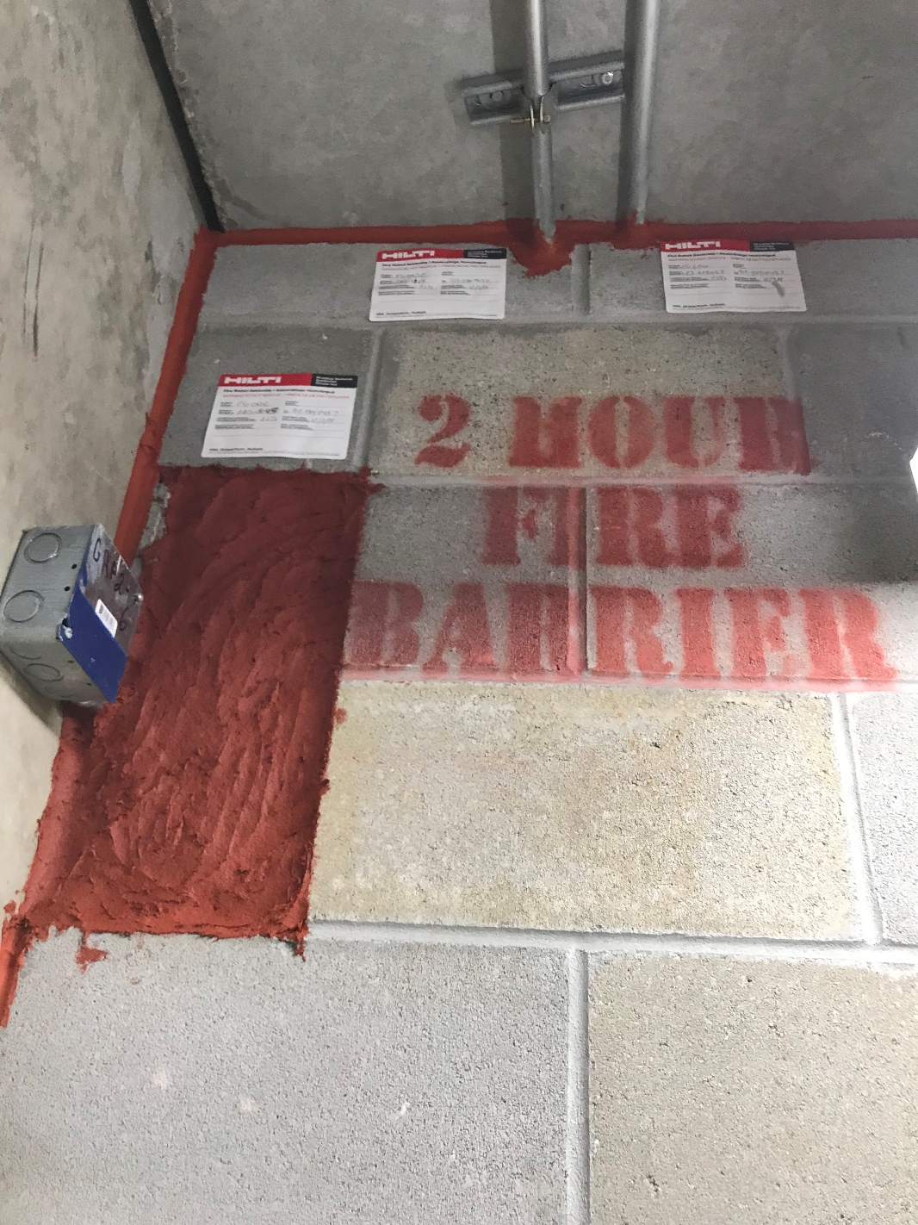
Fire caulk other uses
SCO Conference 2019

Slide 29
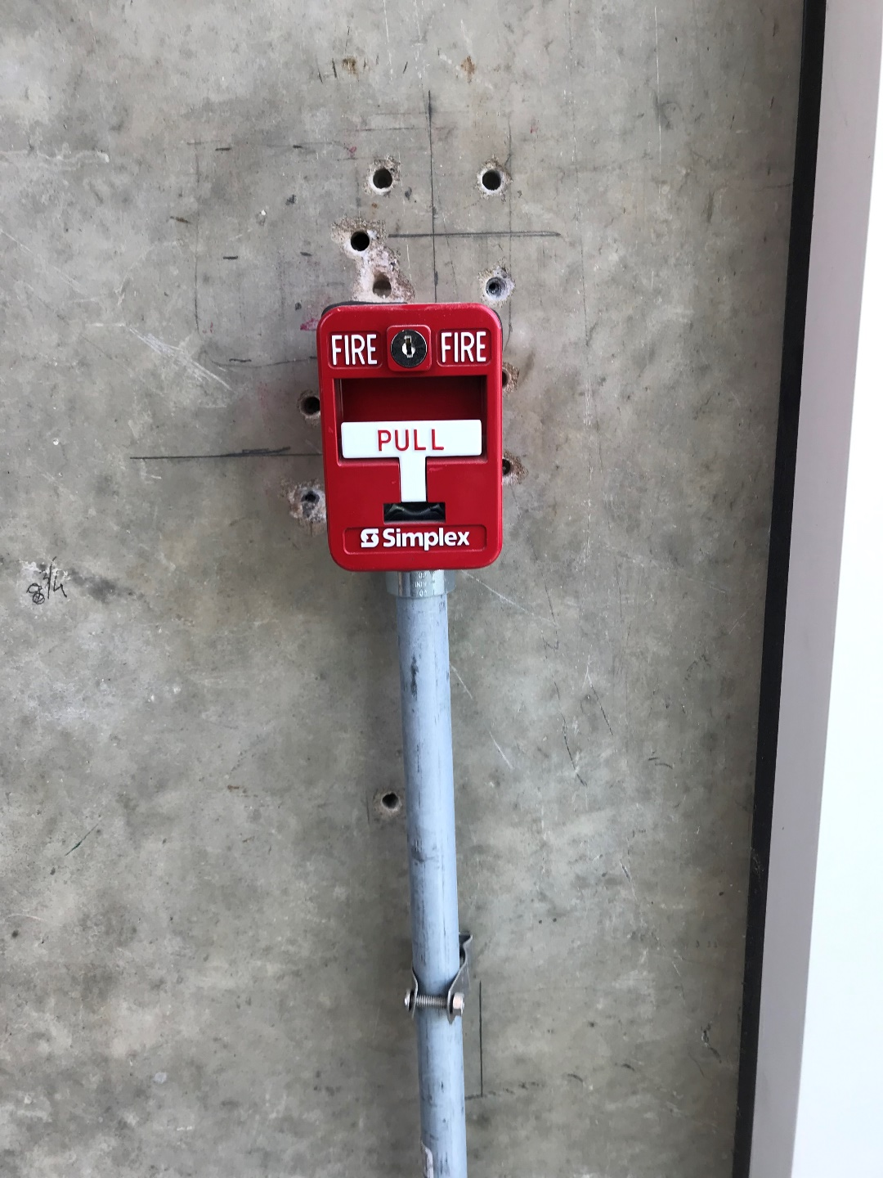
The location was unclear on plans
SCO Conference 2019

Slide 30
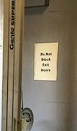
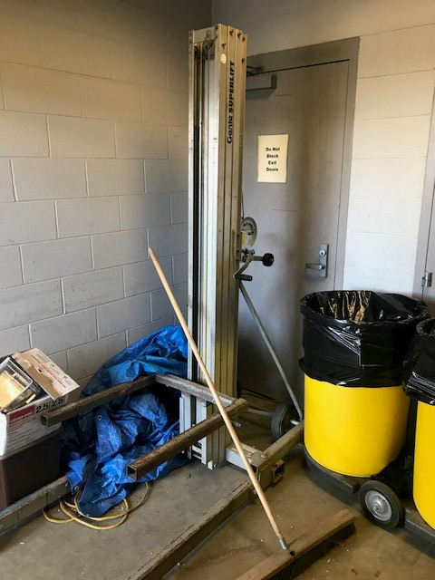
Can’t Exit through this door
SCO Conference 2019

Slide 31
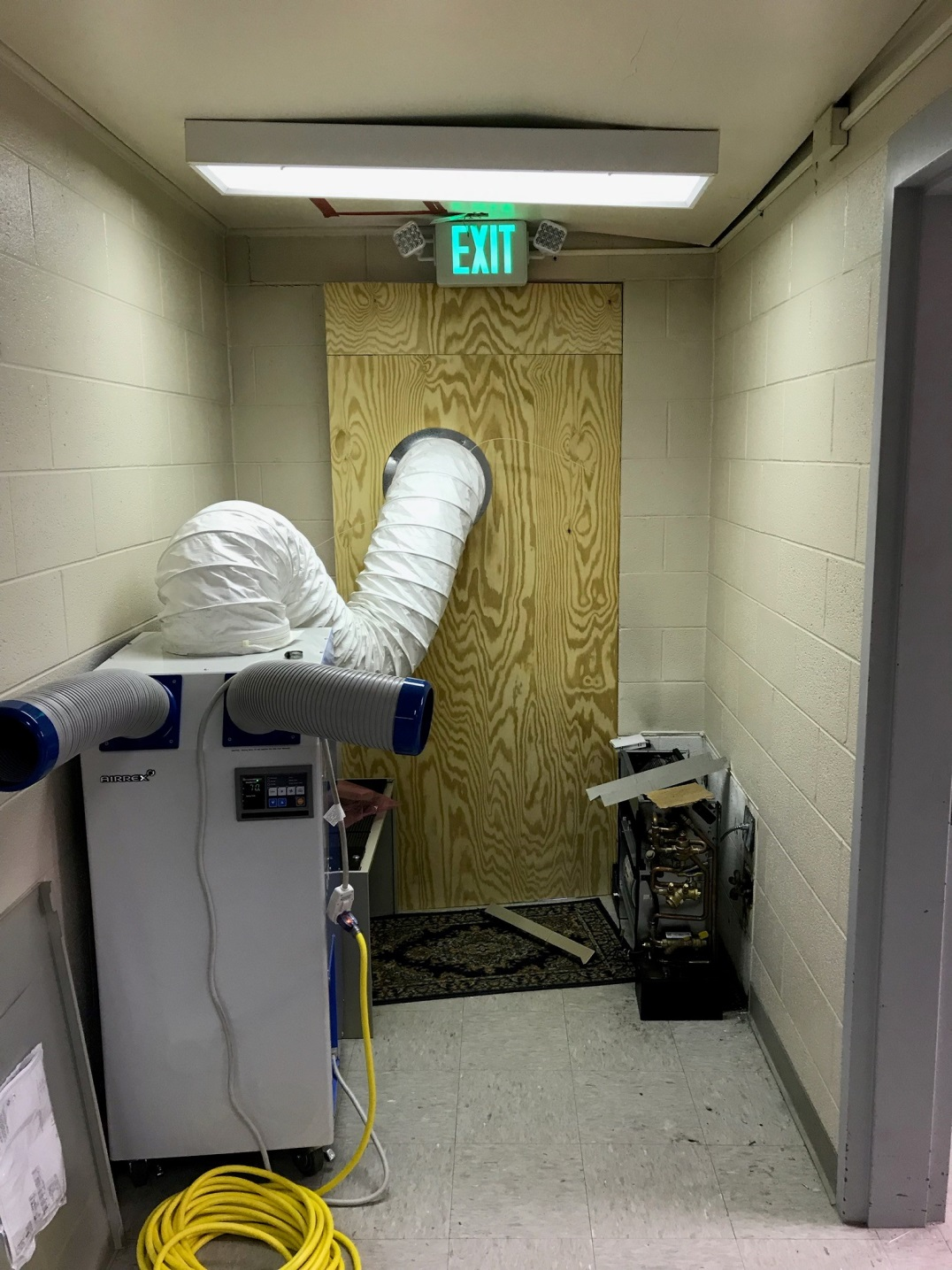
Can’t go through this Exit either
SCO Conference 2019

Slide 32
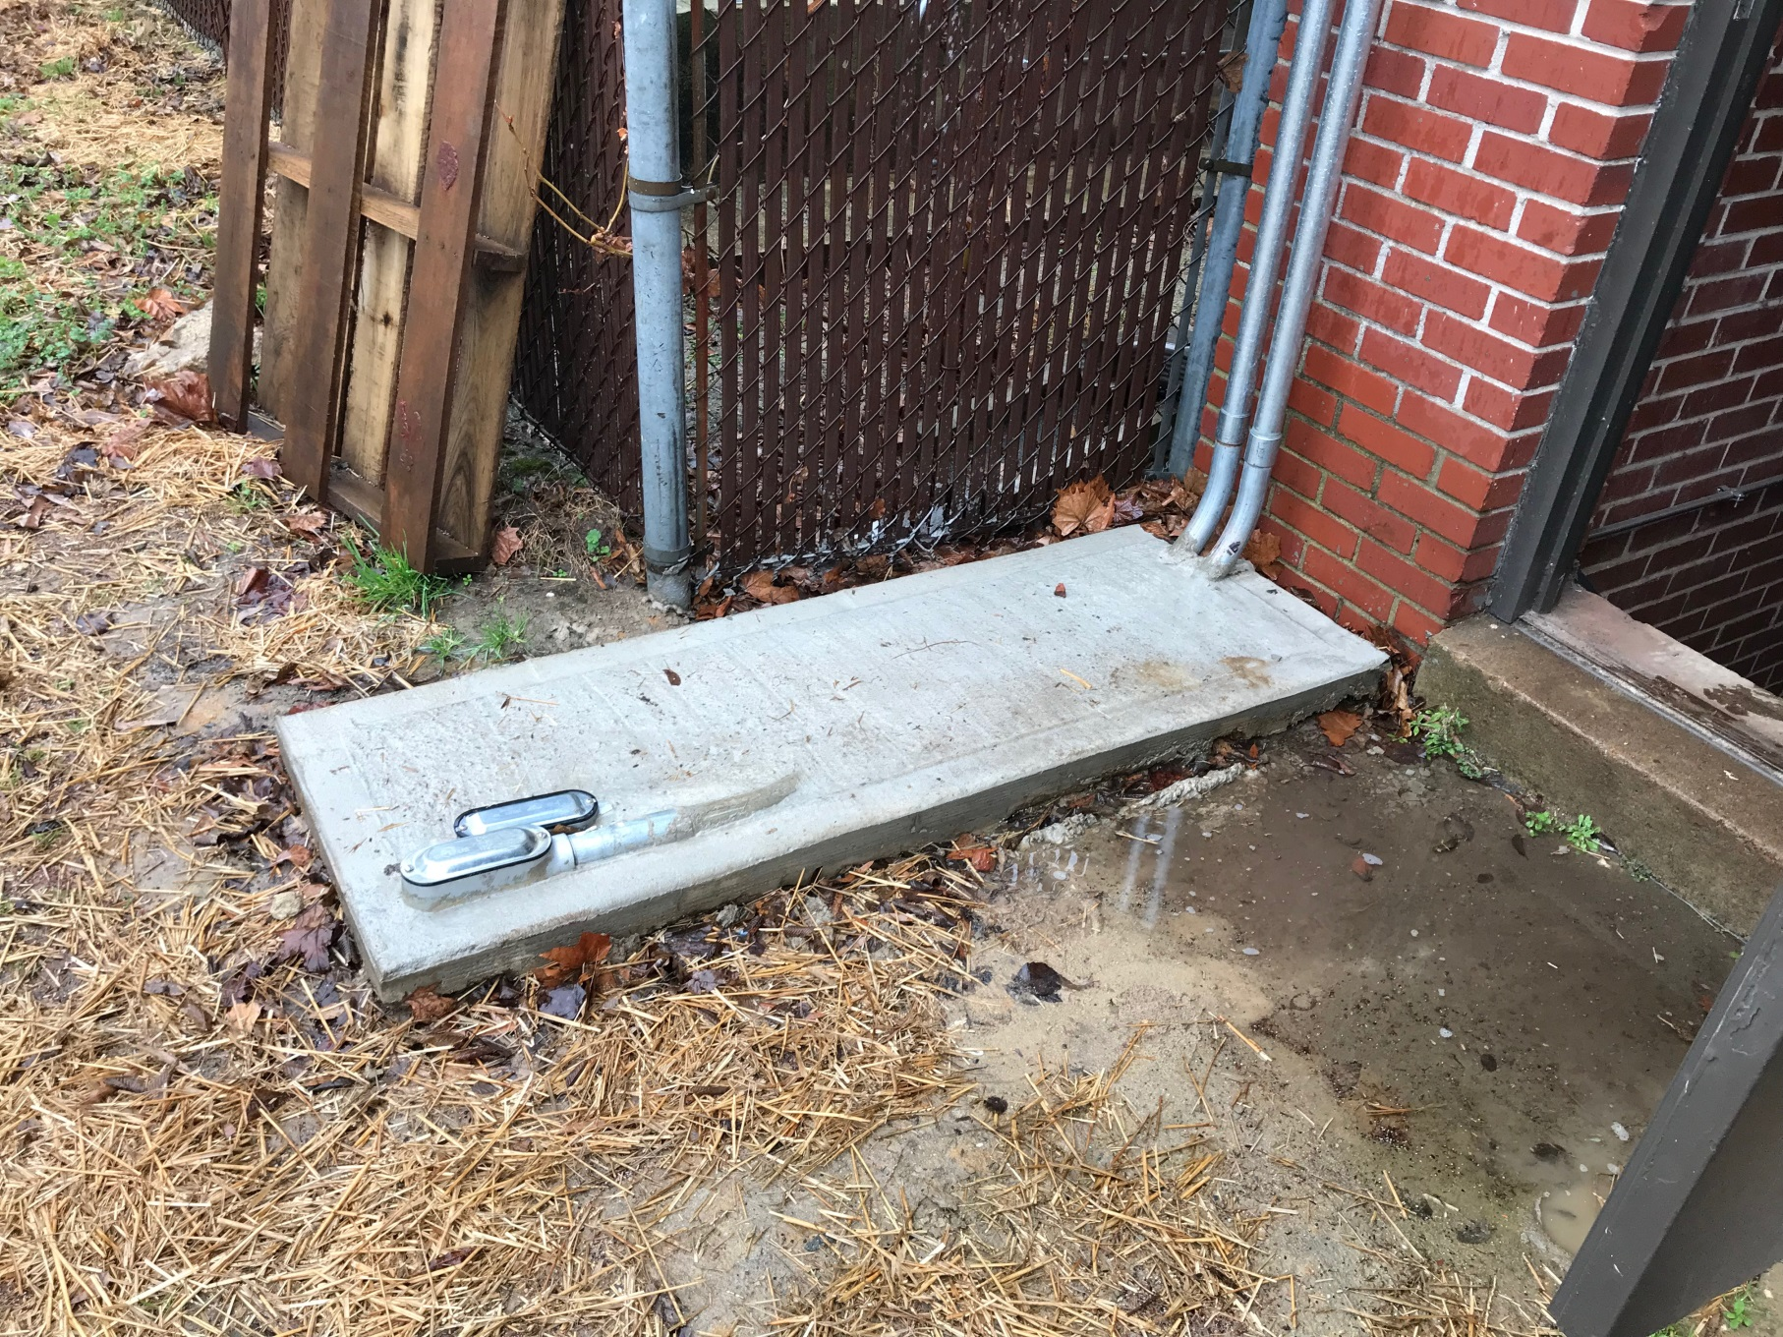
Solving a hazard while creating a new one
SCO Conference 2019

Slide 33
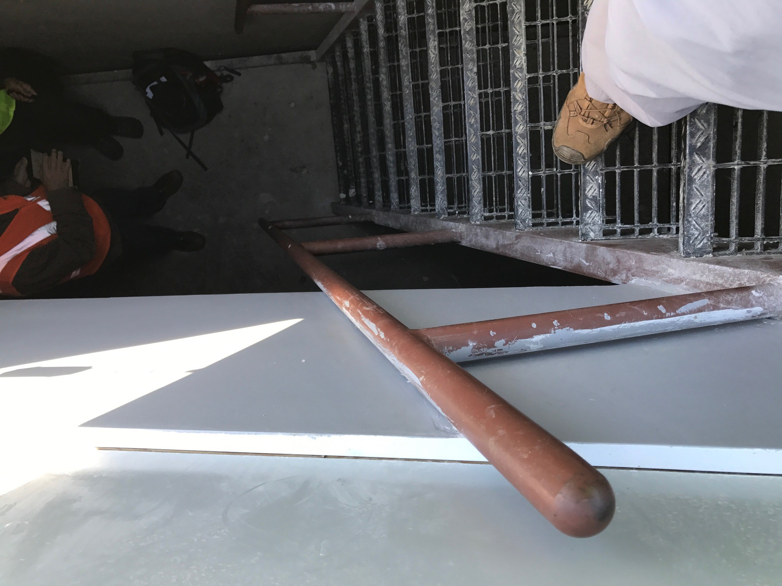
Handrails optional, use the stair treads
SCO Conference 2019

Slide 34
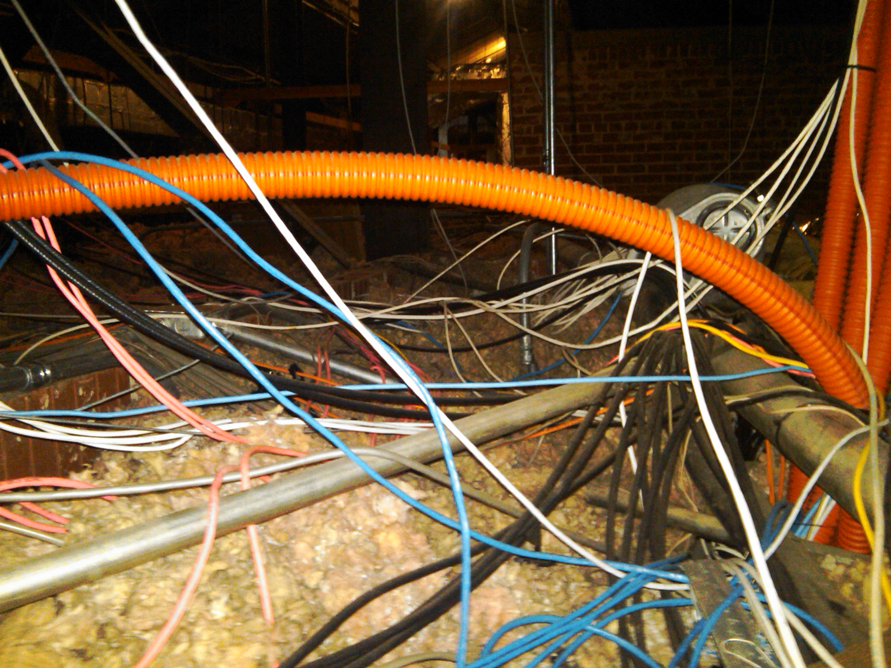
Maintenance Electrician's nightmare
SCO Conference 2019

Slide 35
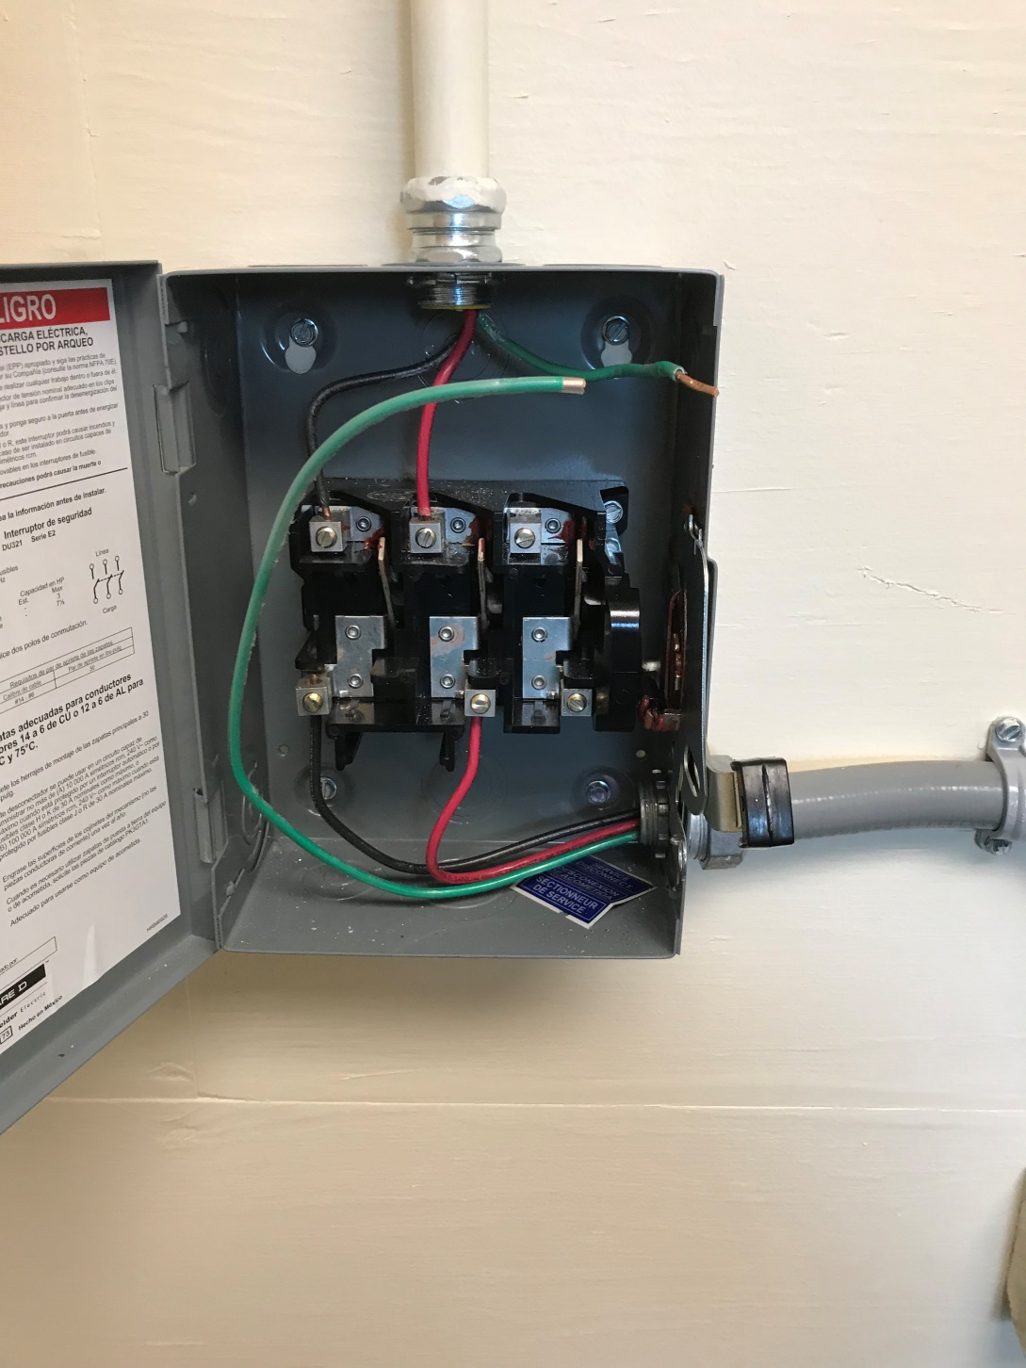
How was the grounding test done?
SCO Conference 2019

Slide 36
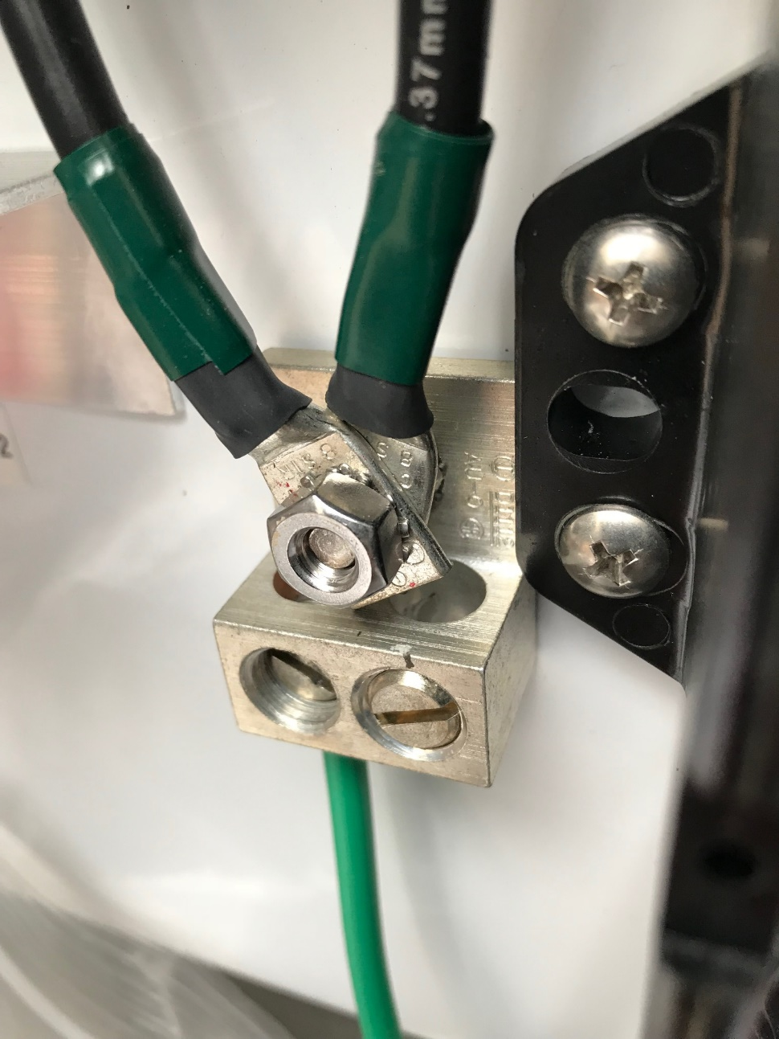
Is this proper electrical grounding? it works!
SCO Conference 2019

Slide 37
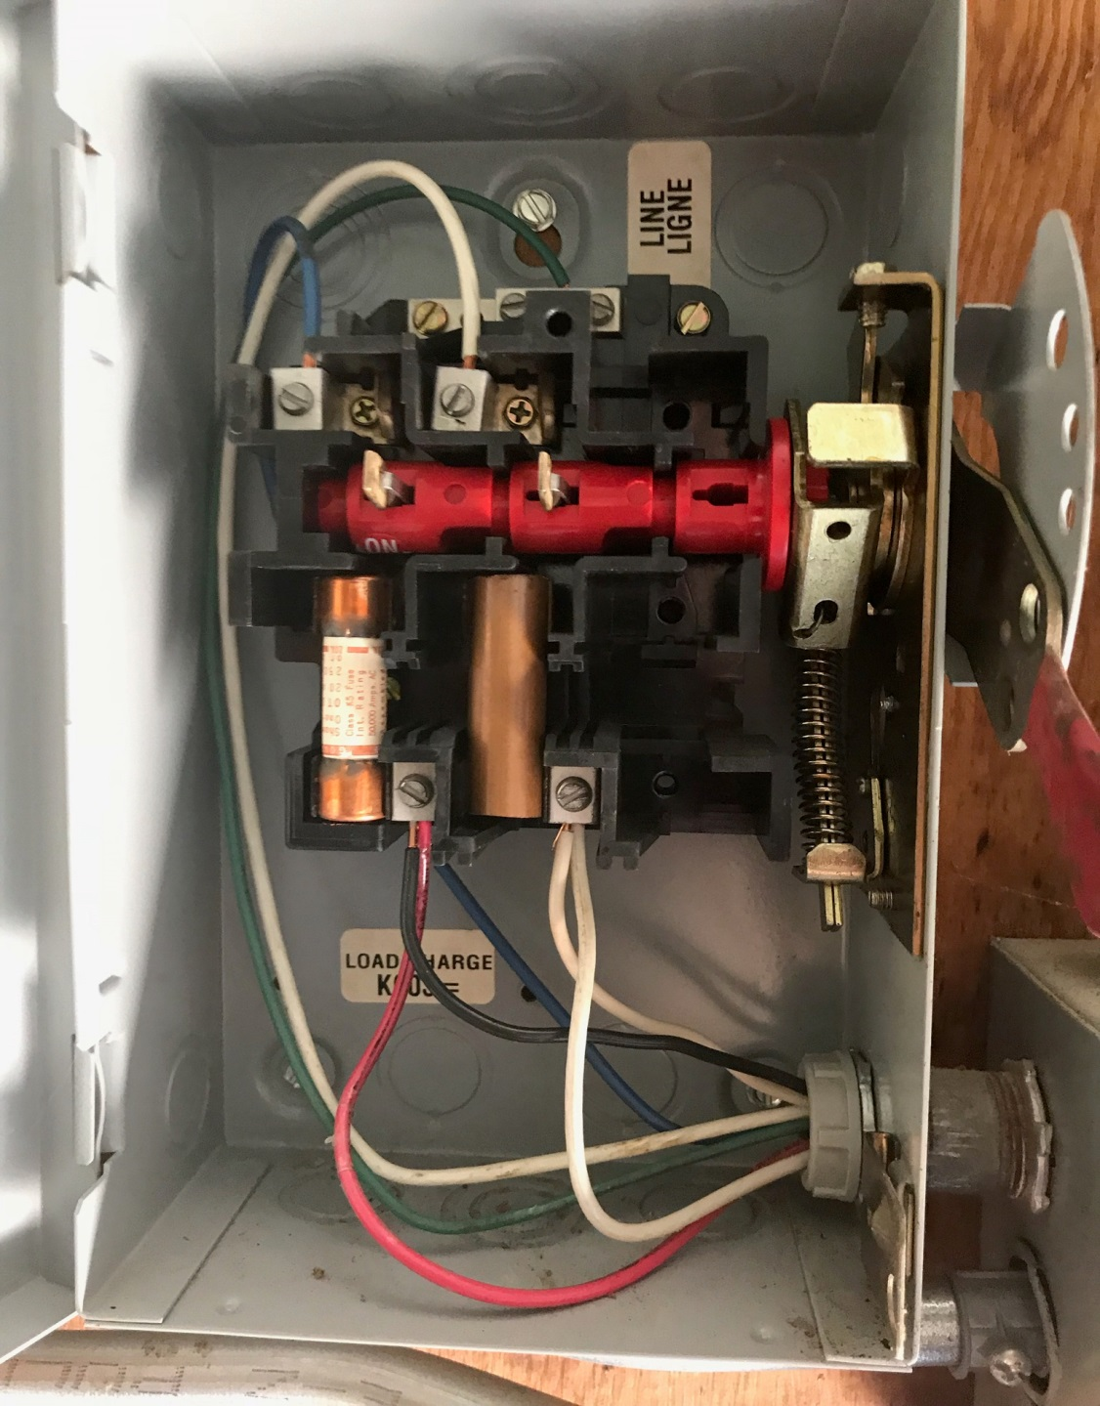
This is just wrong
SCO Conference 2019

Slide 38
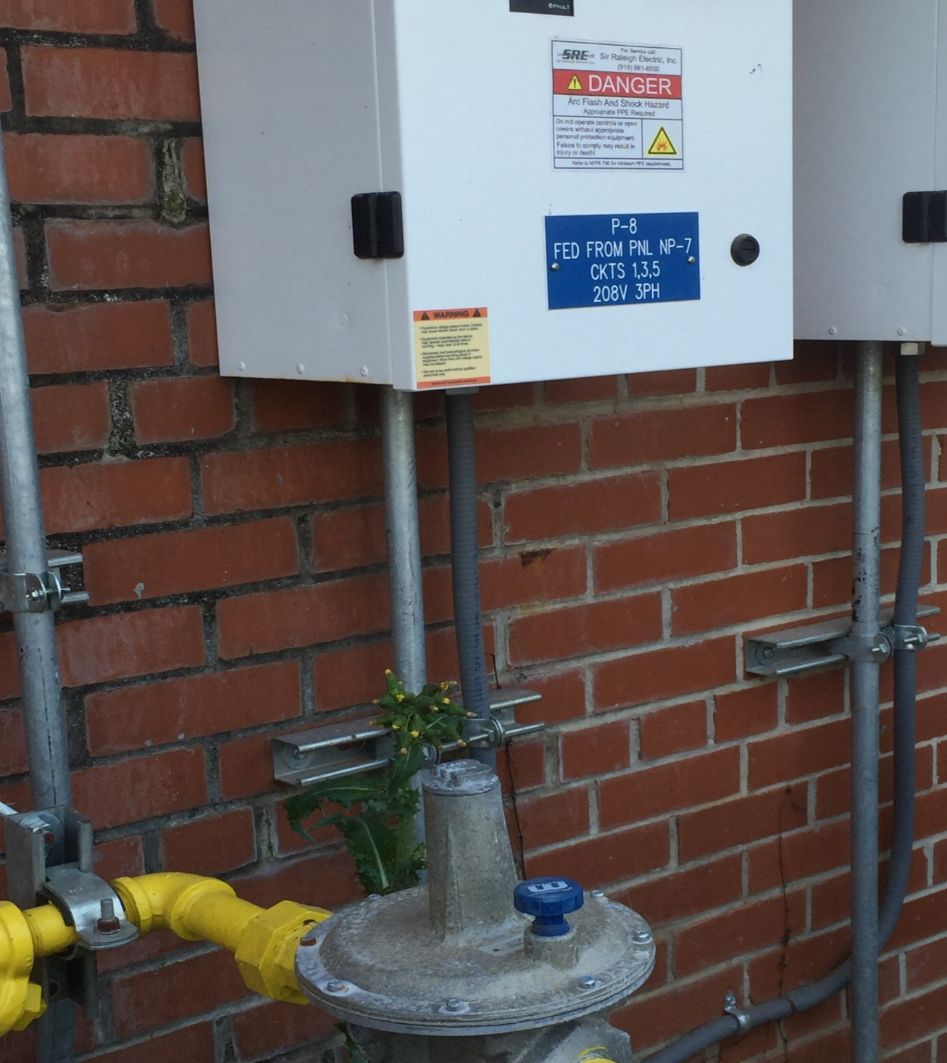
The worst possible location
SCO Conference 2019

Slide 39
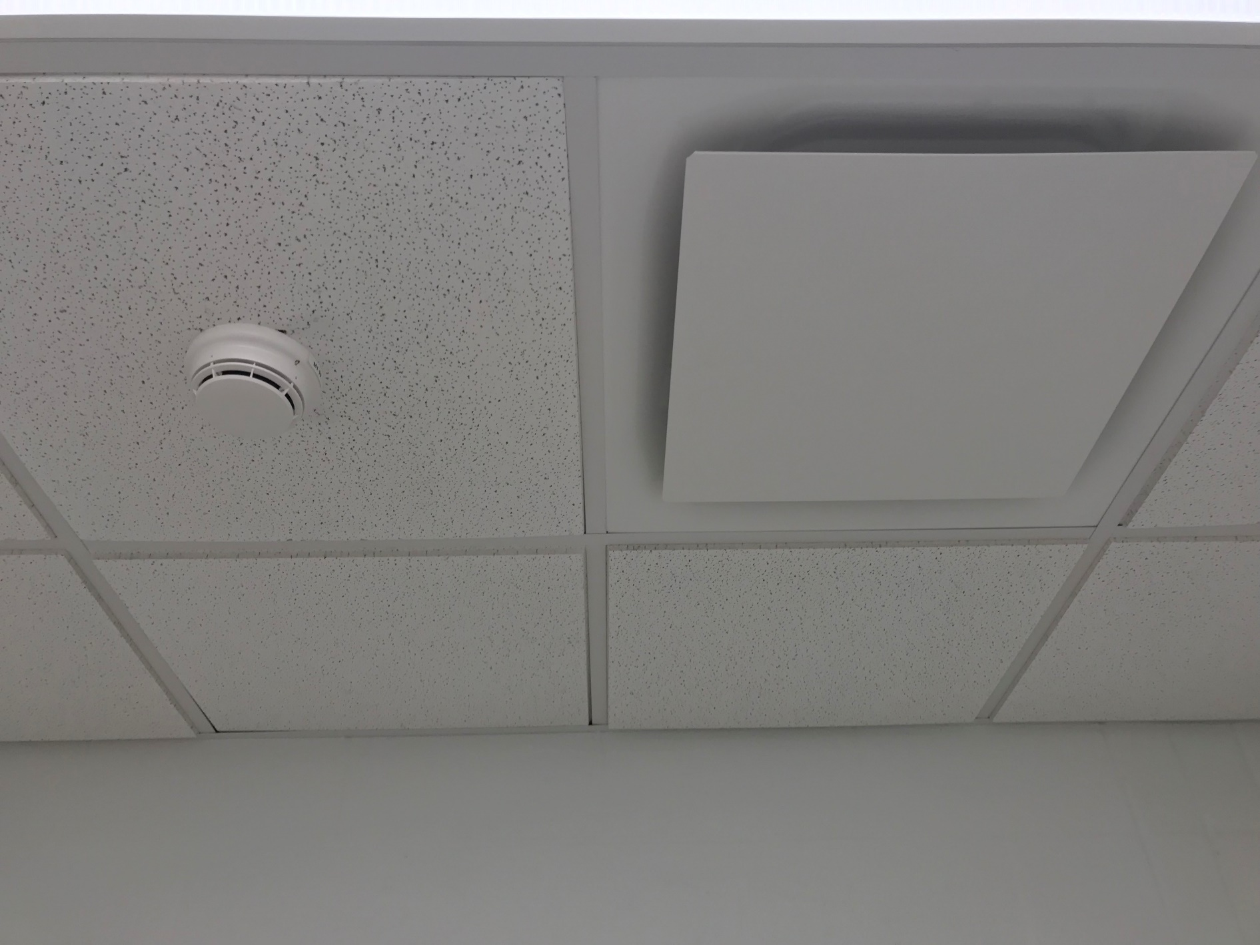
Who should fix this?
36” Min
SCO Conference 2019

Slide 40
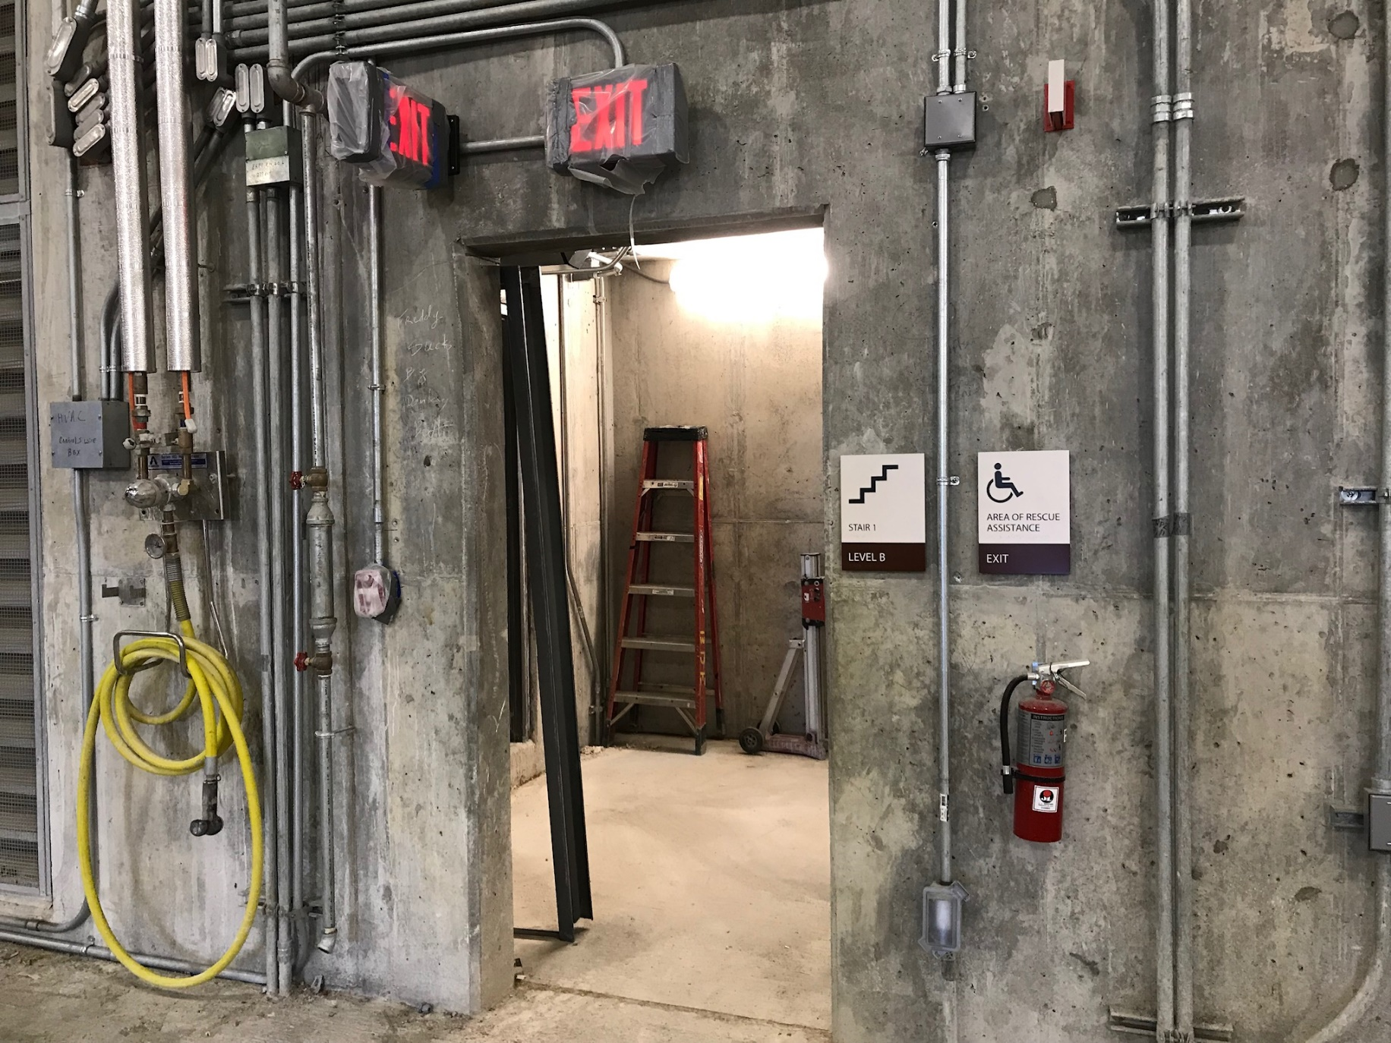
Too early for a Life Safety inspection
SCO Conference 2019

Slide 41
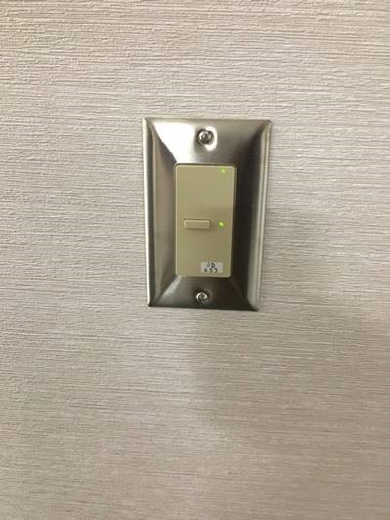
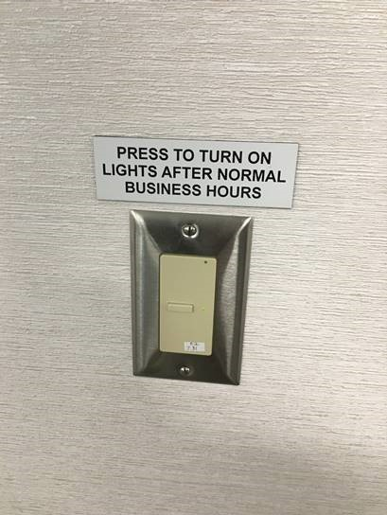
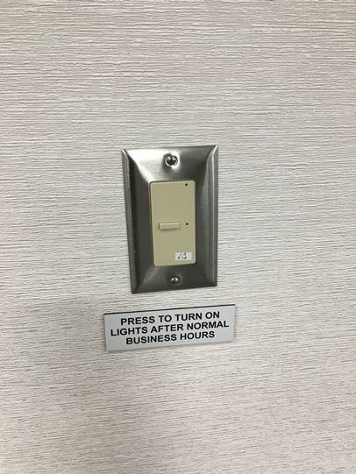
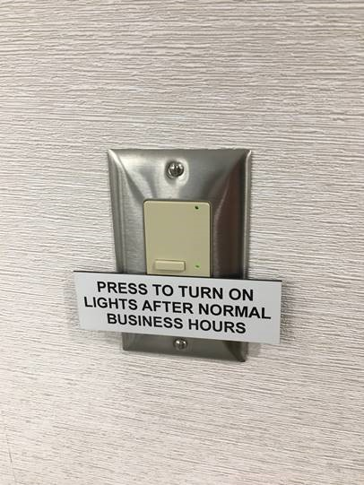
Just be consistent!
SCO Conference 2019

Slide 42
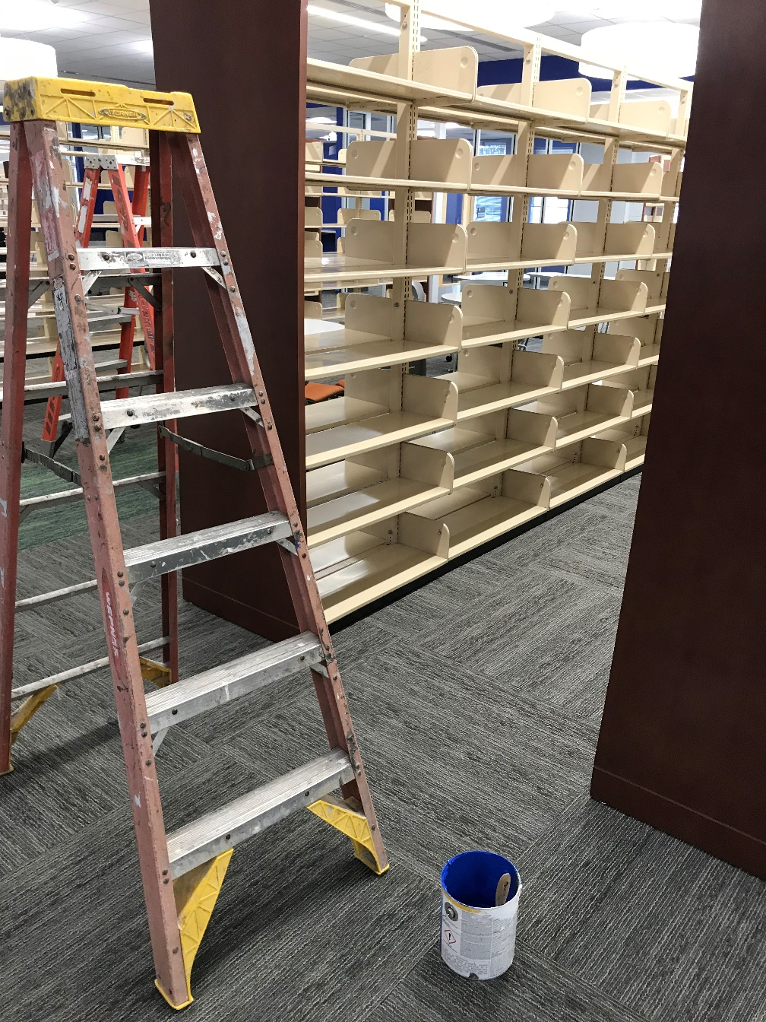
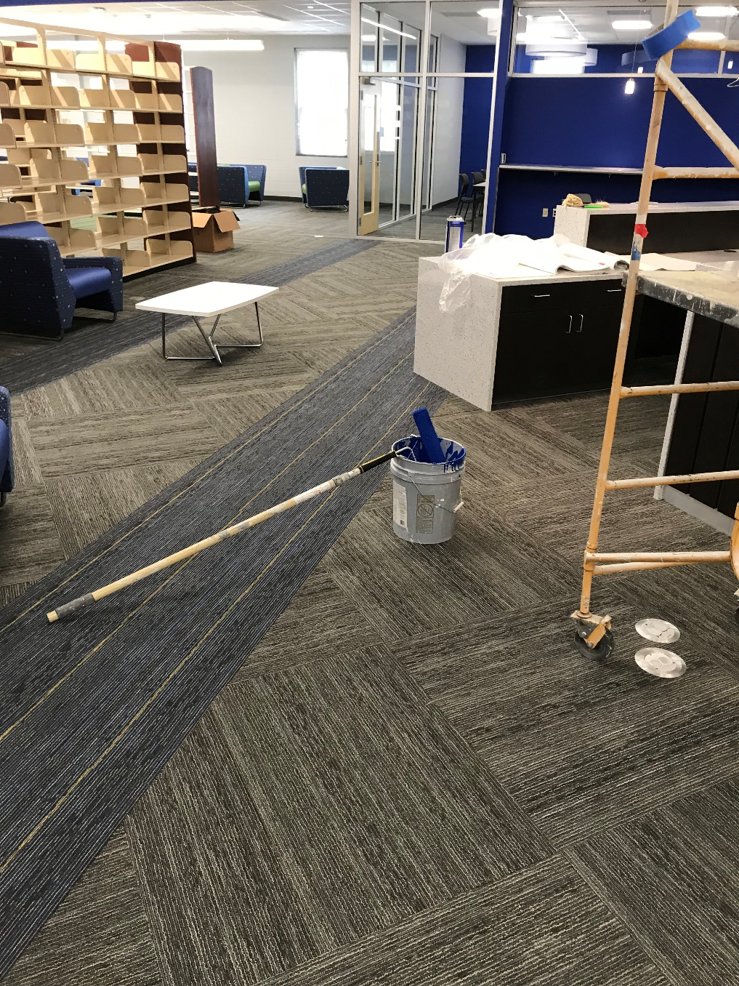
The “Very Careful” touch-up painter
SCO Conference 2019

Slide 43
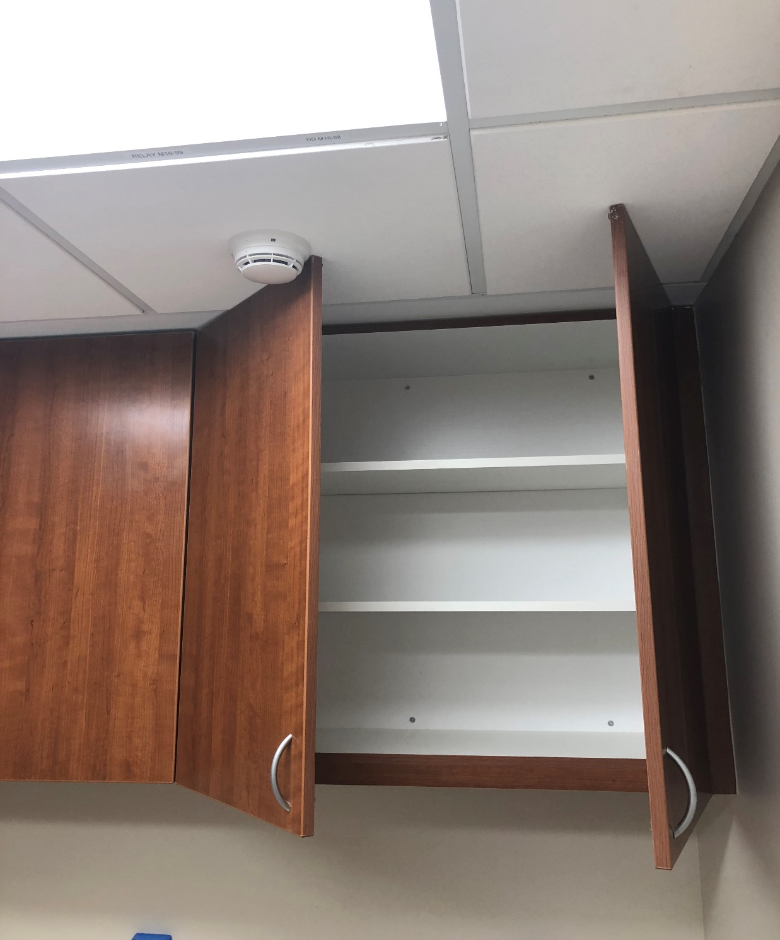
Oops
SCO Conference 2019

Slide 44
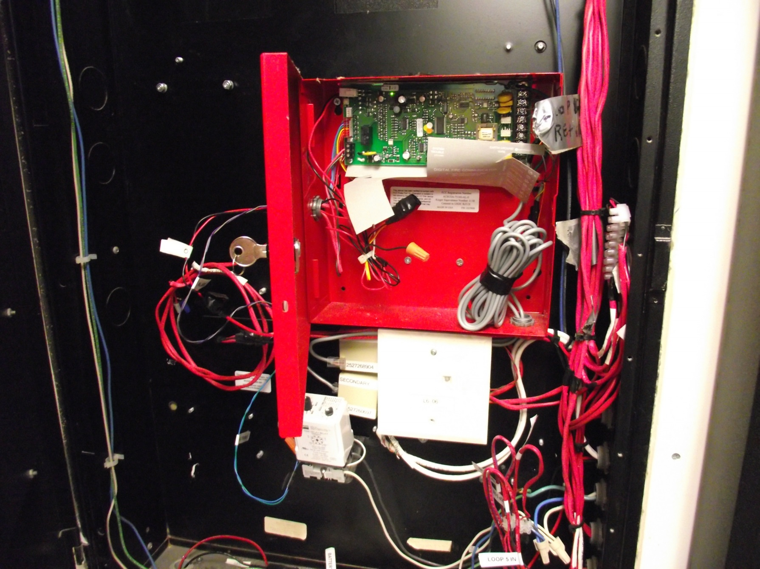
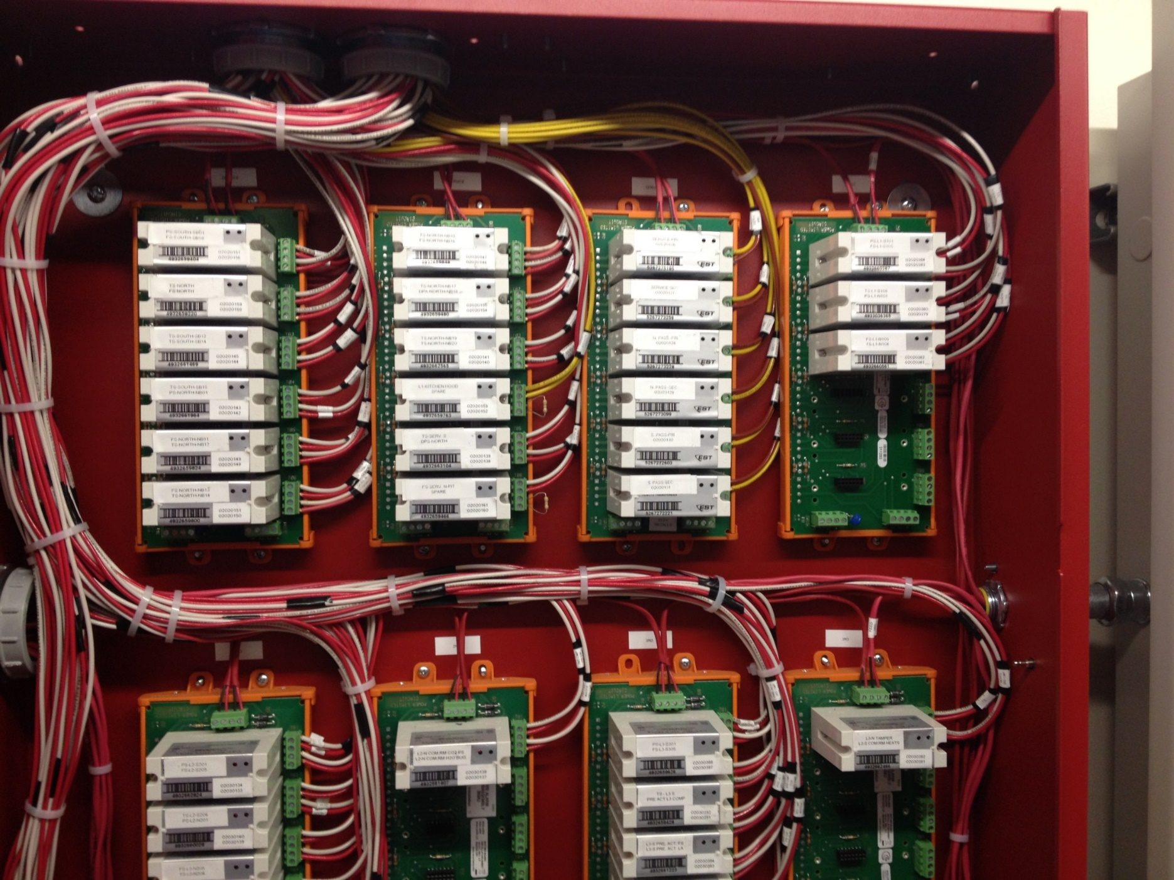
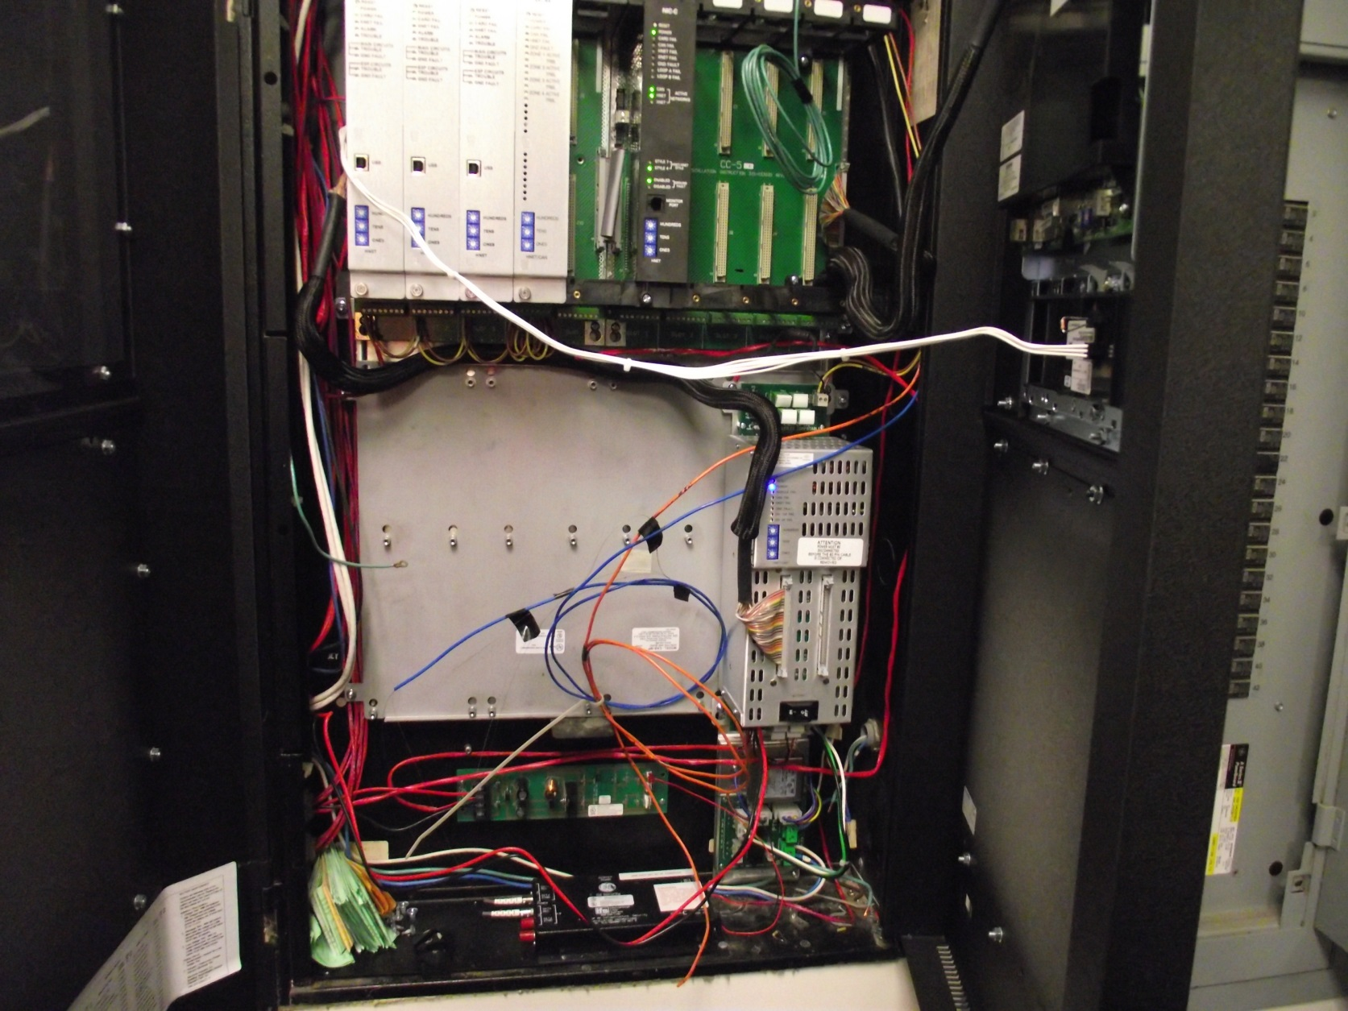
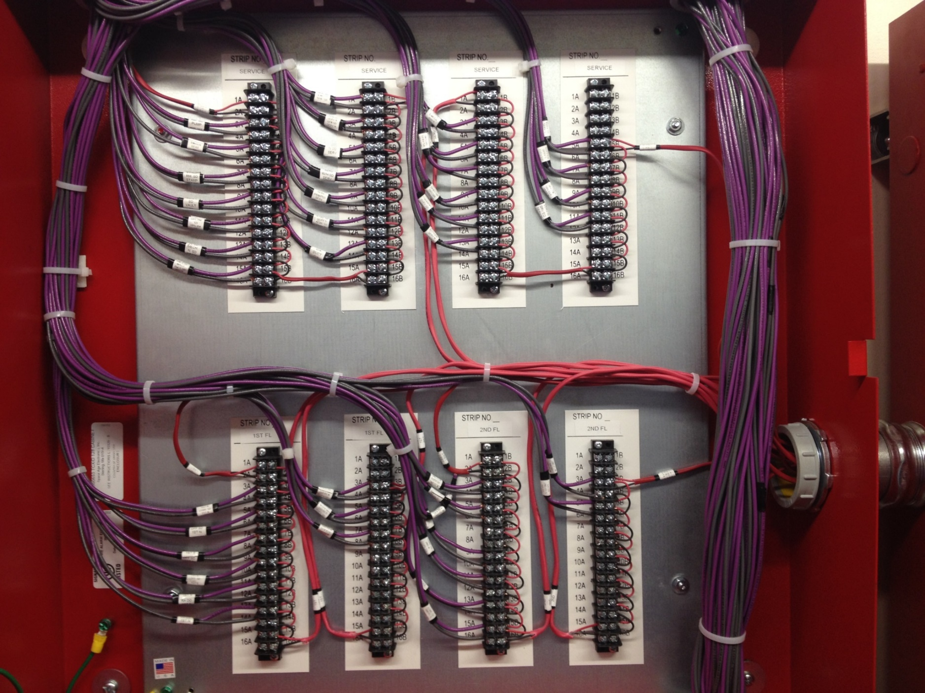
Do’s & don’ts in control wiring
SCO Conference 2019

Slide 45
SCO Conference 2019

Slide 46
2018-2019 honorable mention
SCO Conference 2019

Slide 47
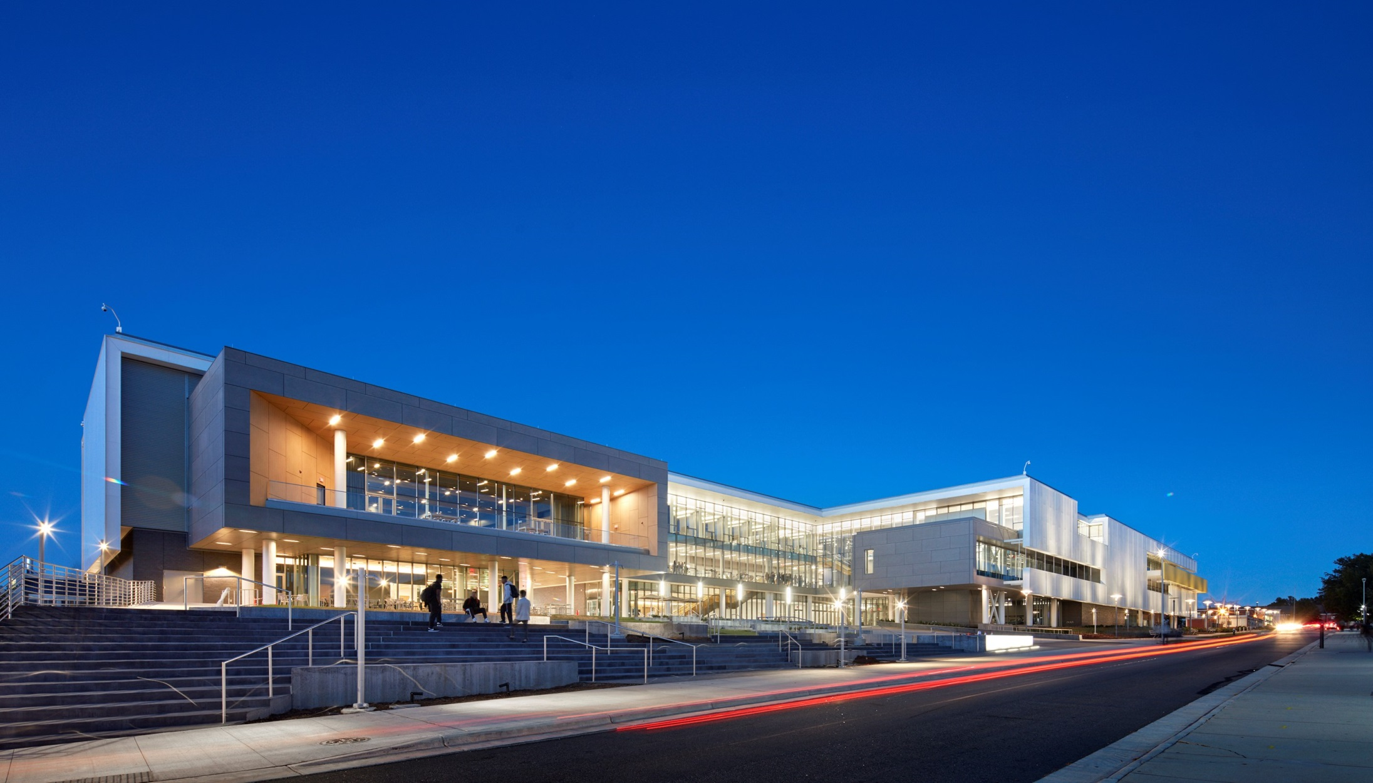
NCA&T New Student Center
Designers: Vines Architecture, RMF, Stewart Eng.
Contractors: JV Balfour Beatty / DH Griffin
SCO Conference 2019

Slide 48
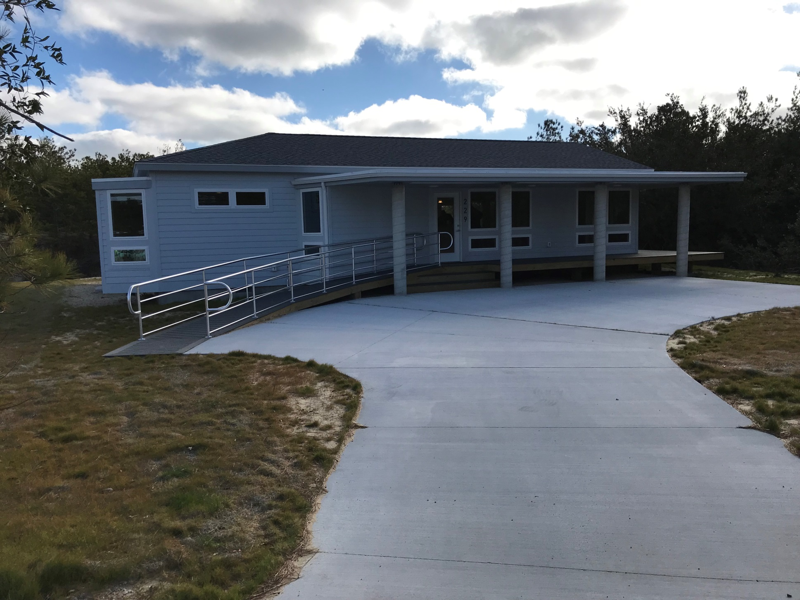
Jockey Ridge State Park – Fire Restoration
Designer: Cahoon & Kasten
Contractor: Godfrey Construction
SCO Conference 2019

Slide 49
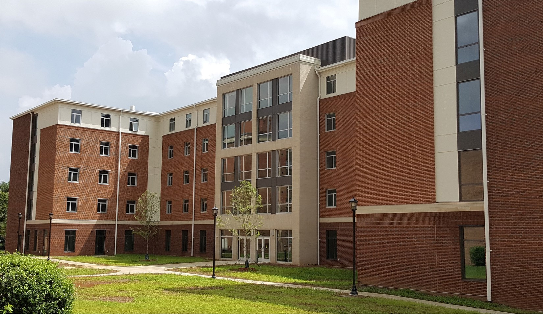
WSSU – Covington Hall
Designers: Lord, Aeck & Sargent
Contractors: JV Balfour Beatty / Holt Brothers
SCO Conference 2019

Slide 50
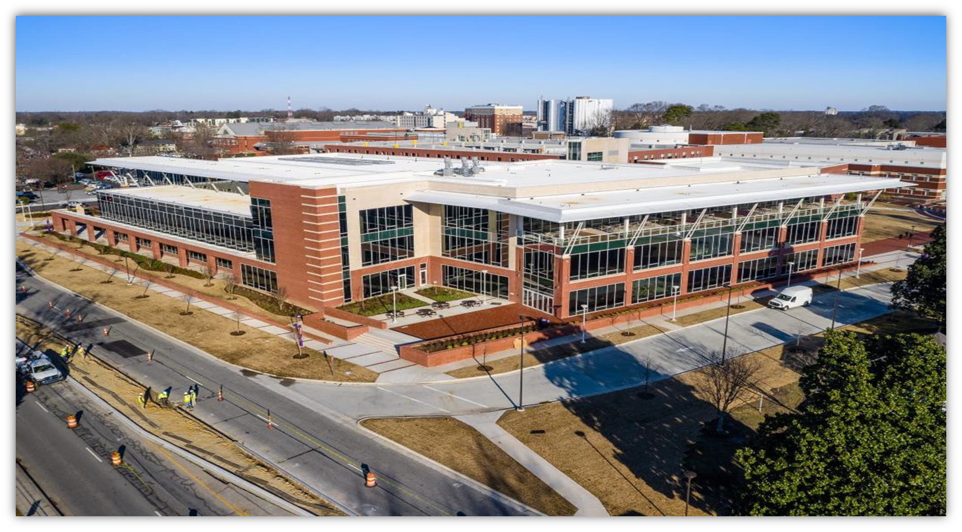
ECU –Student Union & Parking Deck
Designers: Perkins & Will, AEI, Stewart Eng.
Contractors: JV TA Loving, Barnhill & Metcon

Slide 51
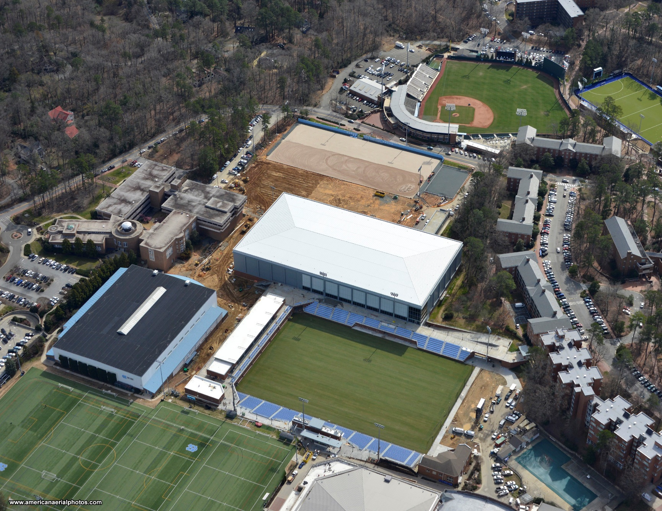
UNC –Fetzer Stadium & Indoor Practice Facility
Designer: CRA Associates
Contractors: JV with TA Loving / Clancey & Theys

Slide 52
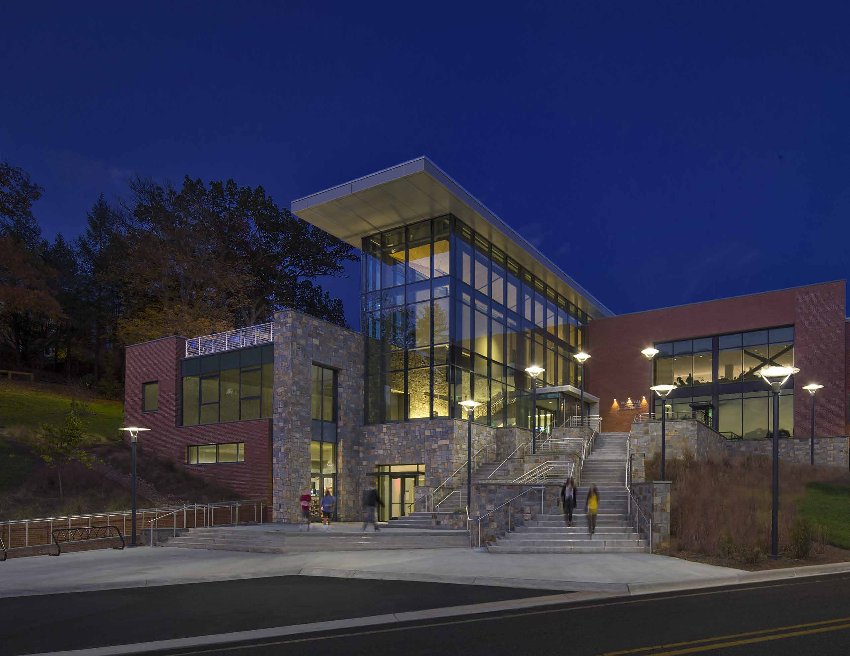
WCU –Brown Building Renovation & Addition
Designer: Watson Tate Savory
Contractor: Vannoy Construction

Slide 53
Thank you
Questions? Send email to
Latif.kaid@doa.nc.gov
SCO Conference 2019

