Slide 1
Domestic Violence Intervention Program Statistical Report Tutorial

Slide 2
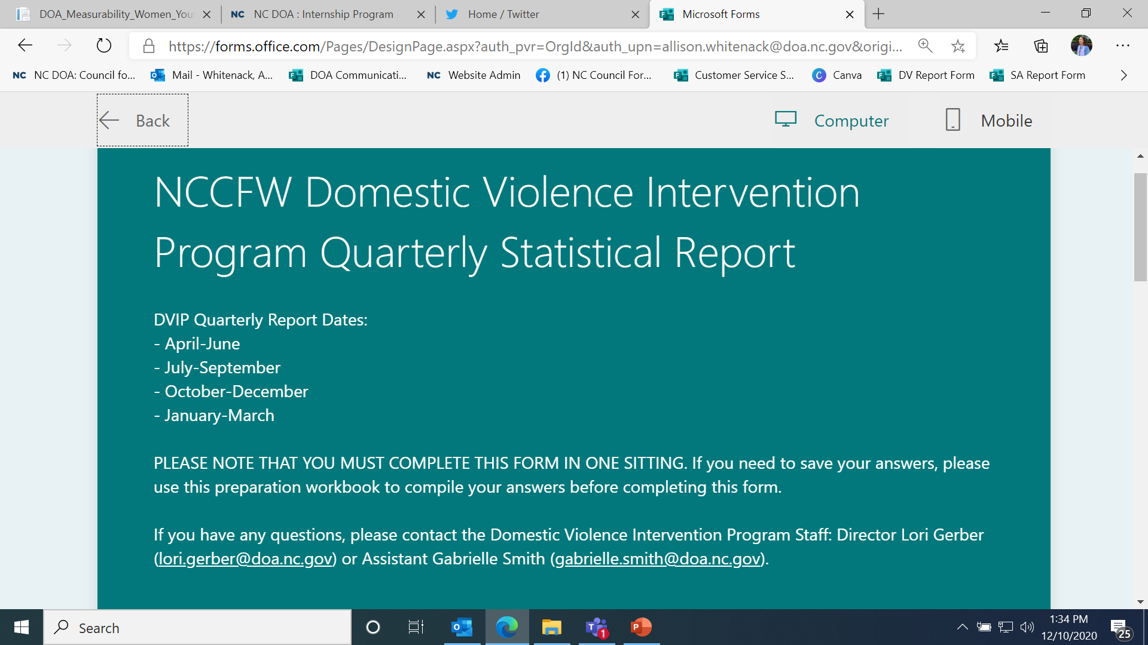
This is the beginning of the report. You will notice that you MUST complete the form in one sitting. Therefore, access the link for a preparation tool to prep your responses before filling out this form.
If you have questions about the report itself, you can contact Allison.Whitenack@doa.nc.gov.

Slide 3
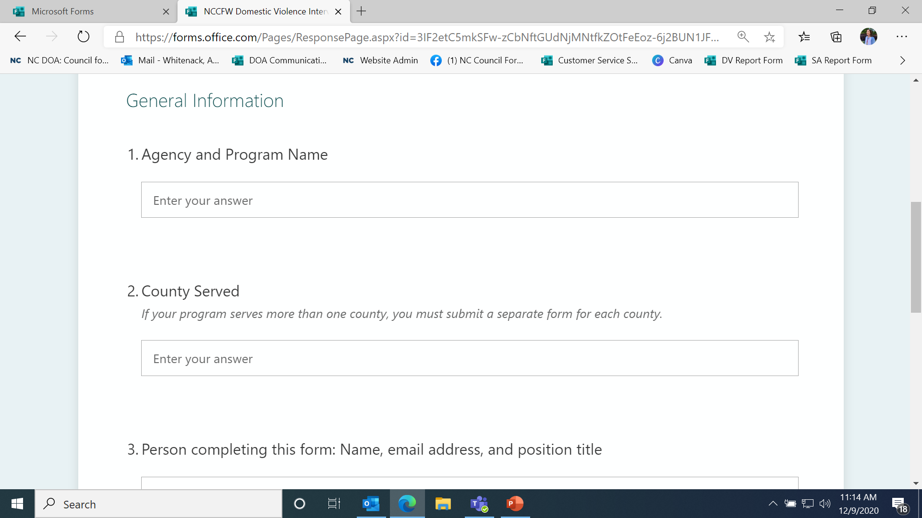
All of these questions should look familiar to you. They are the same as the workbook you have been using this fiscal year. Just click on the field that says “Enter your answer.”

Slide 4
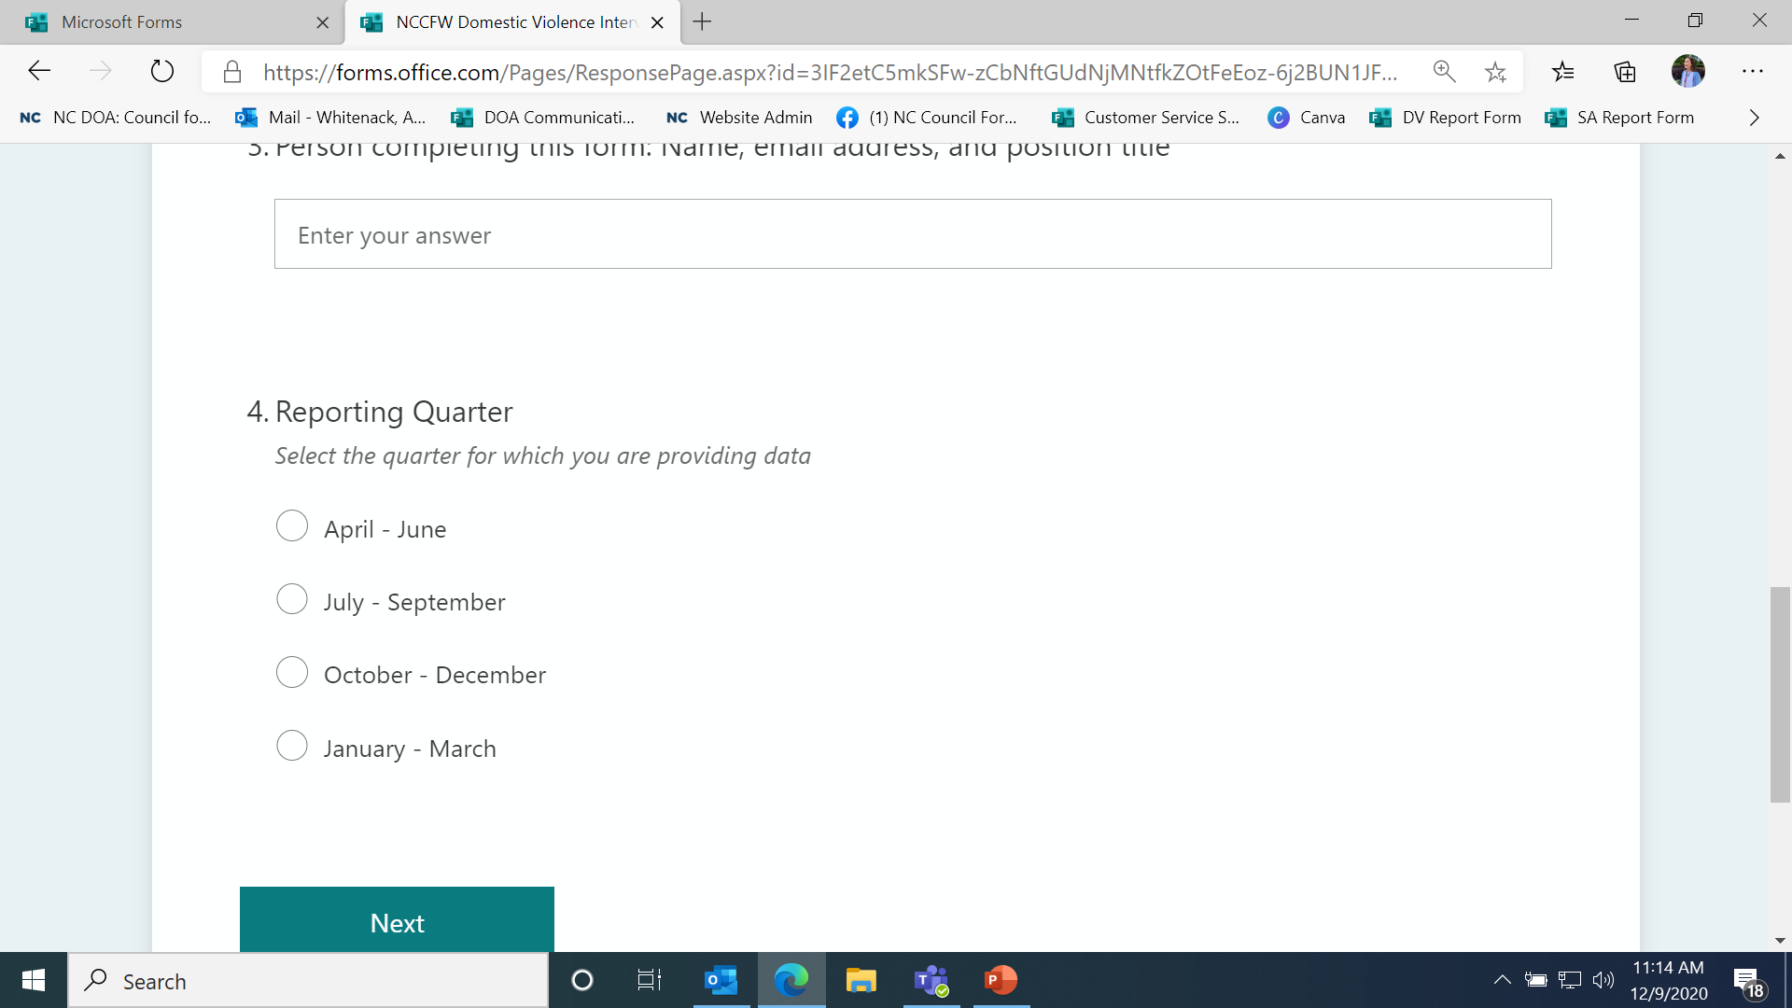
Select the reporting quarter for which you are submitting data.

Slide 5
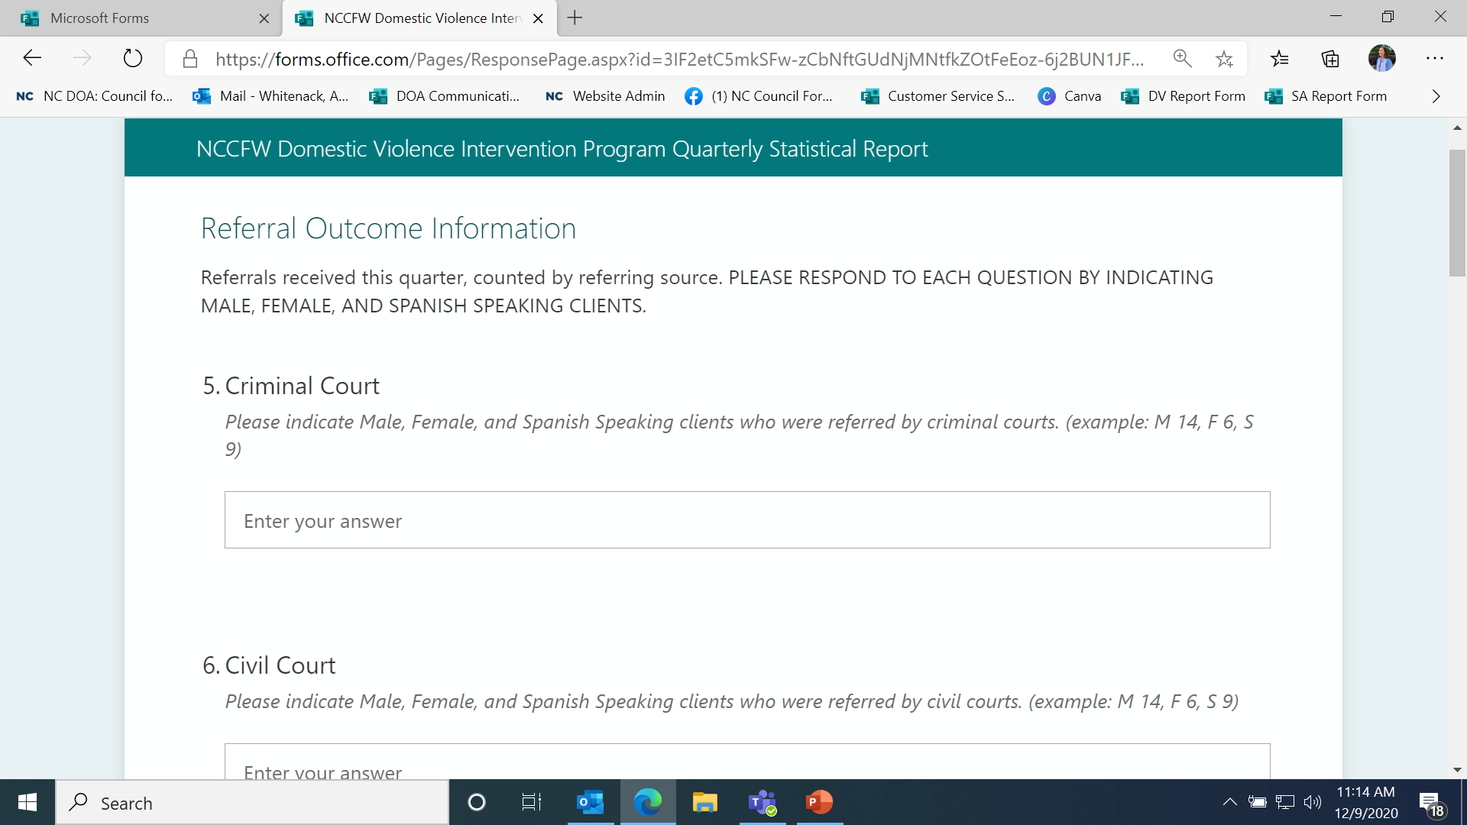
This is the only change to the report, and it is only a change in formatting. Instead of entering the demographic data in separate boxes, we are asking you to report all people who were referred by criminal court in one field, but indicate how many were men, women, and Spanish speakers. PLEASE DO NOT DOUBLE COUNT REFERRALS.
If you have Spanish Speaking referrals, please only count them separately if you have Spanish only groups. Then, count them as Spanish Speaking and NOT in the gender categories.

Slide 6
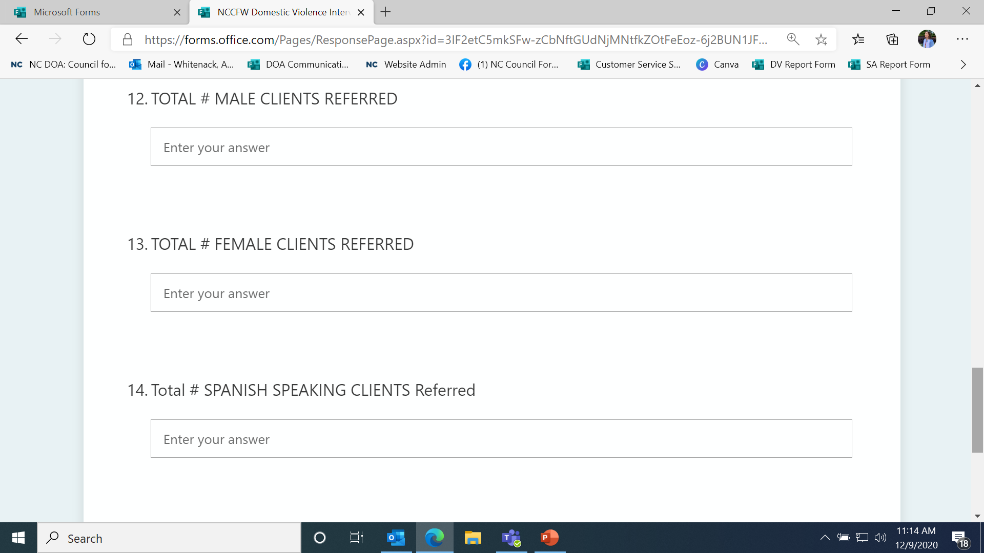
At the end of each section, we still ask for the total clients referred from any source by demographic information. These totals should be consistent with the details you provided earlier in the section.

Slide 7
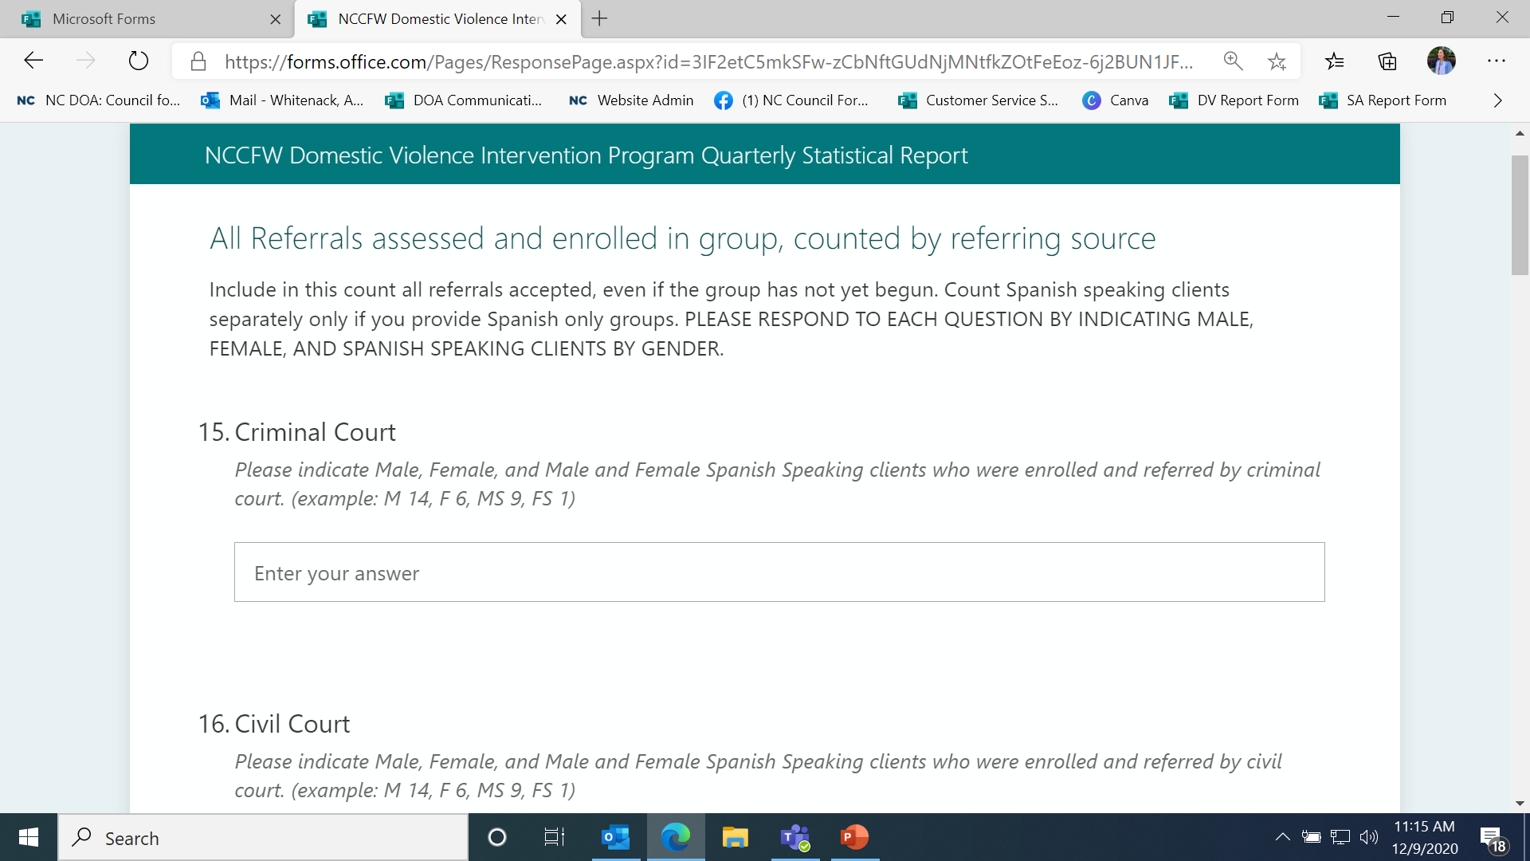
This section asks for referrals who were assessed and ENROLLED. Again, indicate the number of people by referral source and indicate the demographic they fall into. Here, you have the option of noting Male Spanish Speakers and Female Spanish Speakers. Again, please do not double count individuals.

Slide 8
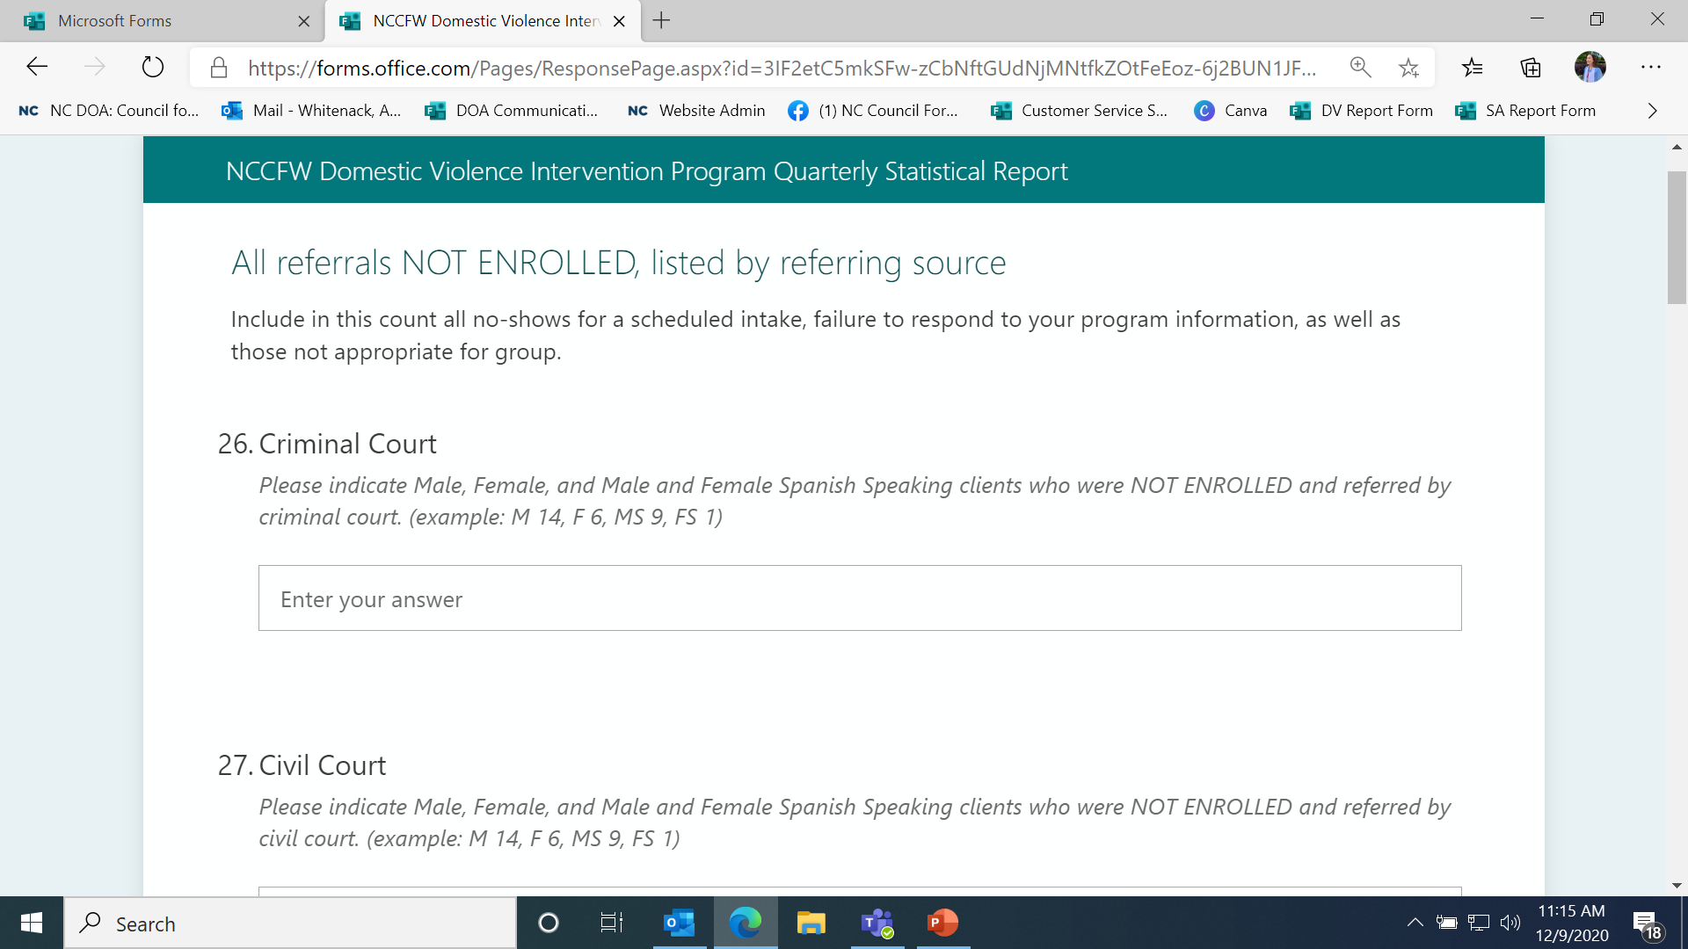
This section asks for referrals who were NOT-ENROLLED. Again, indicate the number of people by referral source and indicate the demographic they fall into. Here, you have the option of noting Male Spanish Speakers and Female Spanish Speakers. Again, please do not double count individuals.

Slide 9
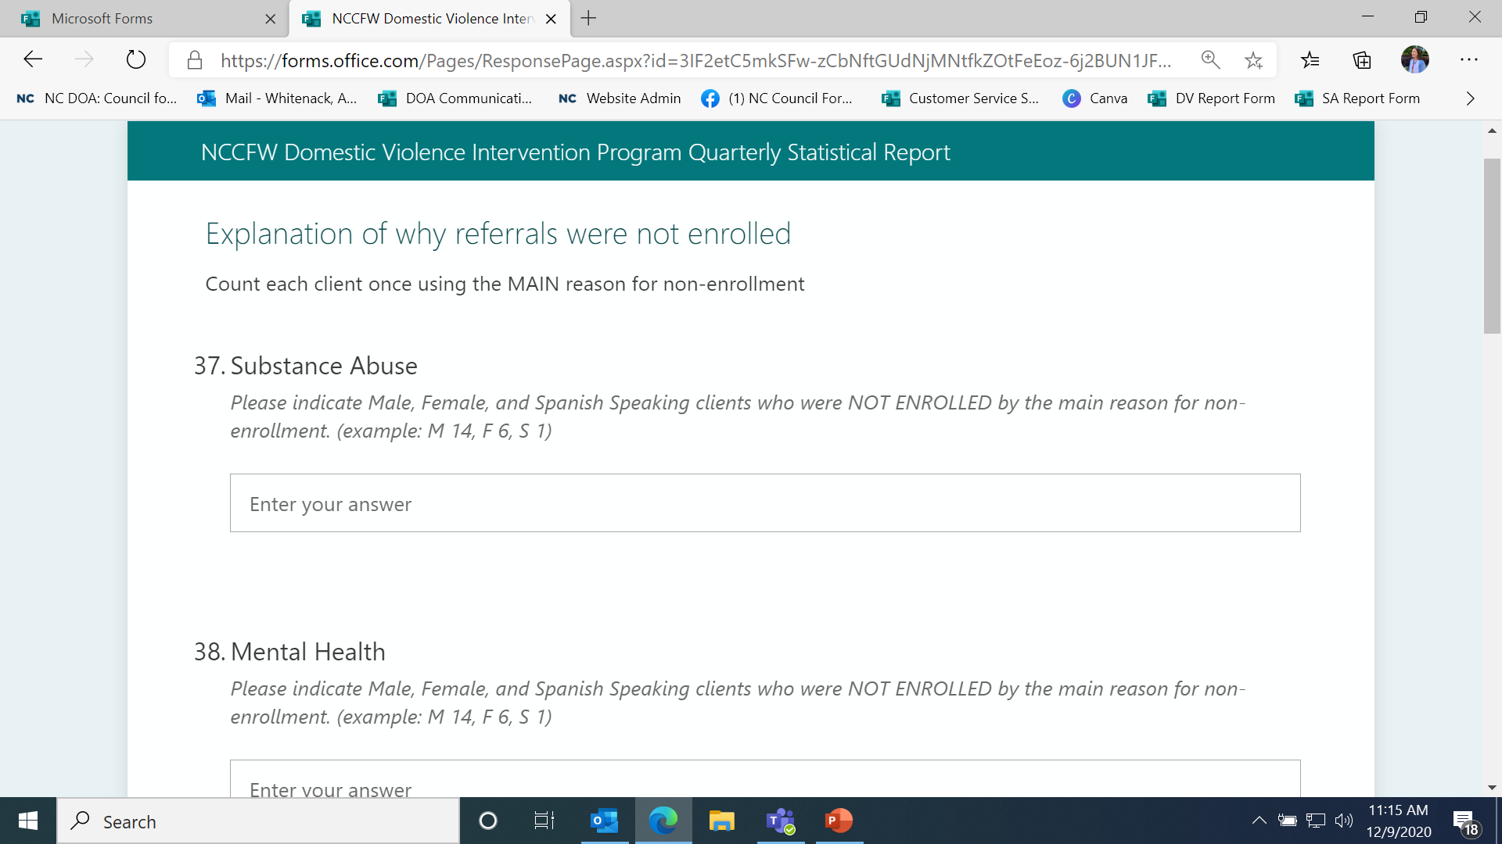
Explanation of non-enrollments, again indicate demographic information. Similar to the second section, if you have Spanish Speaking referrals, please only count them separately if you have Spanish only groups. Then, count them as Spanish Speaking and NOT in the gender categories. DO NOT DOUBLE COUNT INDIVIDALS!

Slide 10
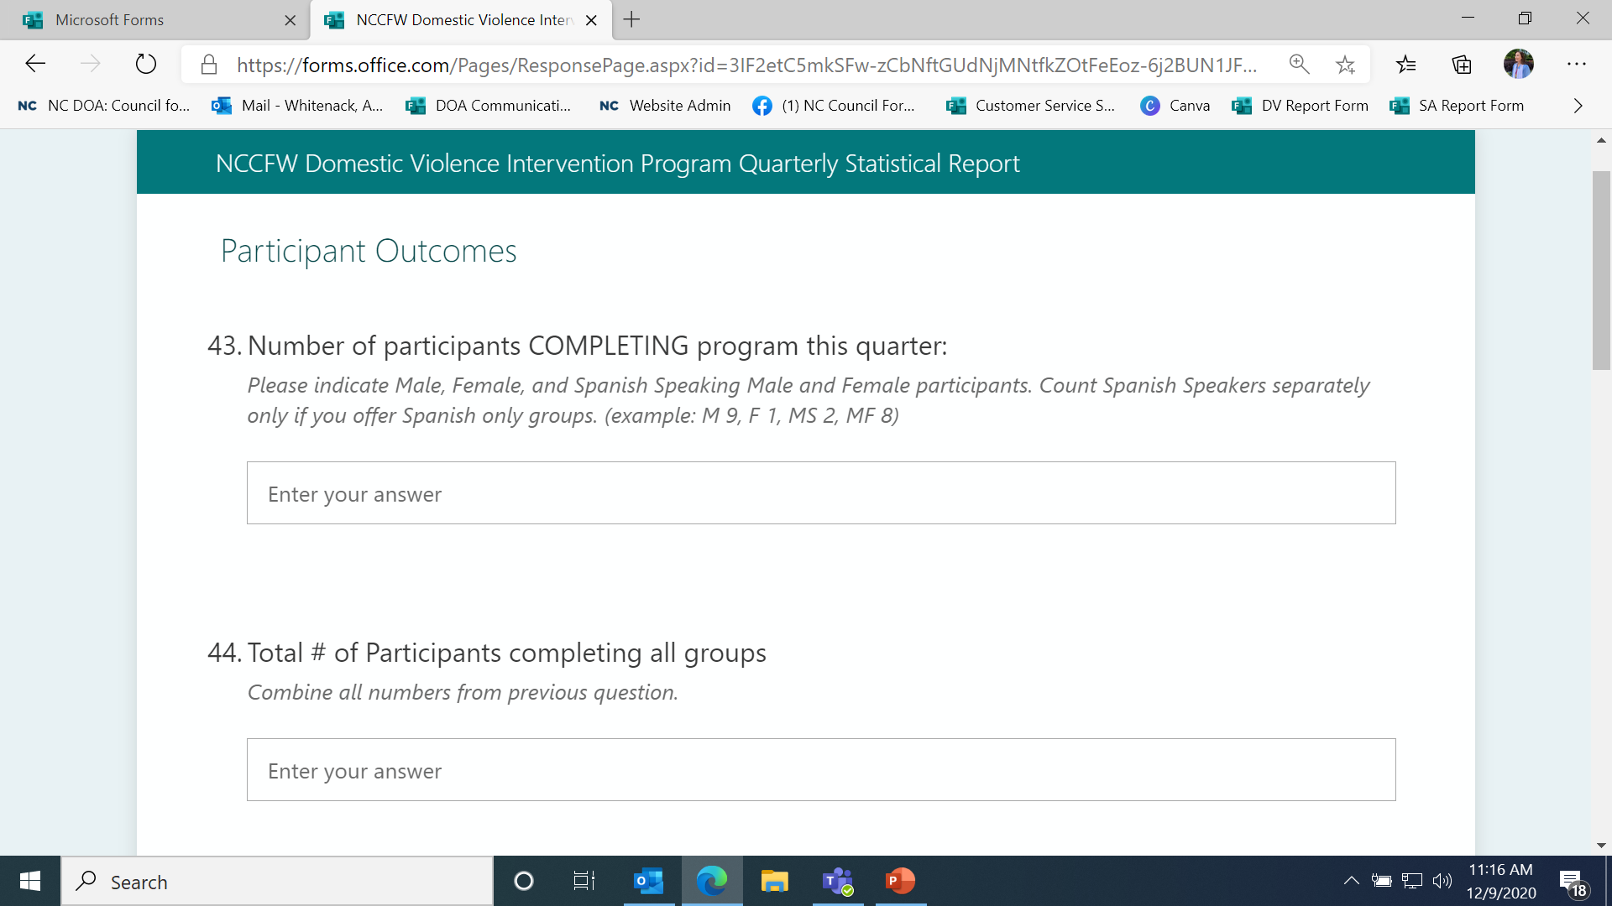
The rest of the sections operate similarly to previous sections. Pay attention to the titles of each section – that will indicate what data you are being asked to submit.

Slide 11
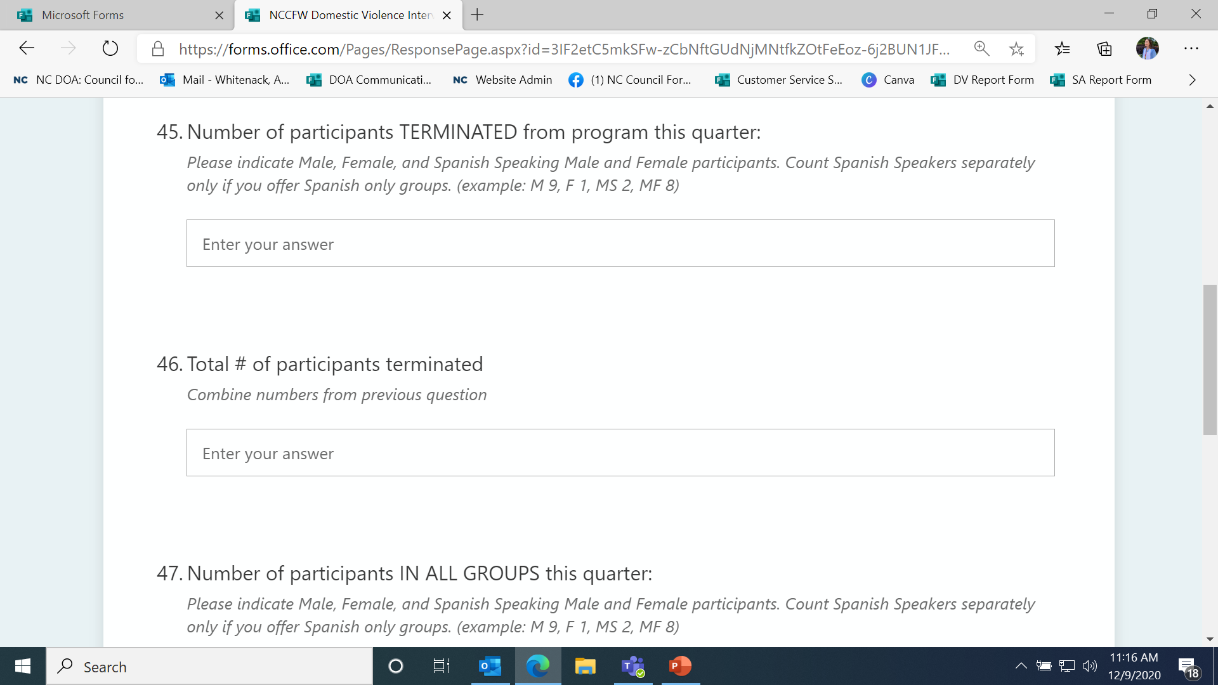

Slide 12
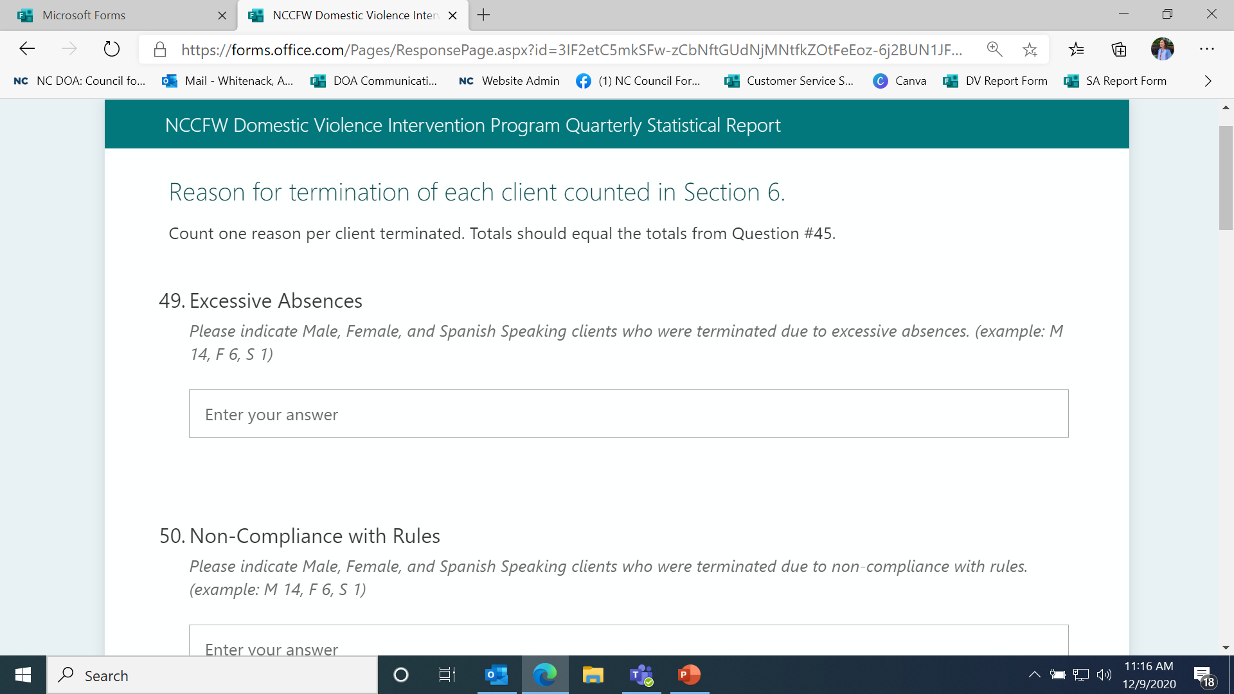

Slide 14
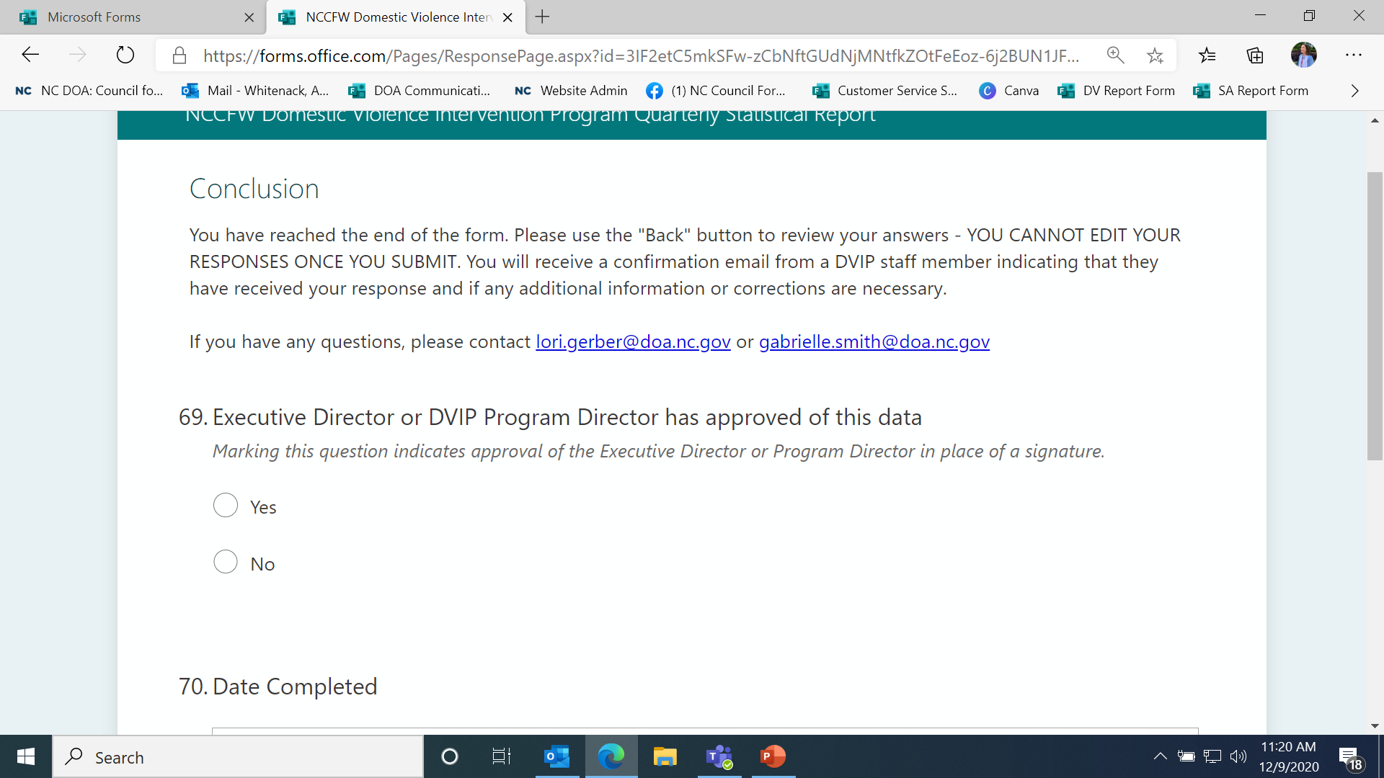

Slide 15
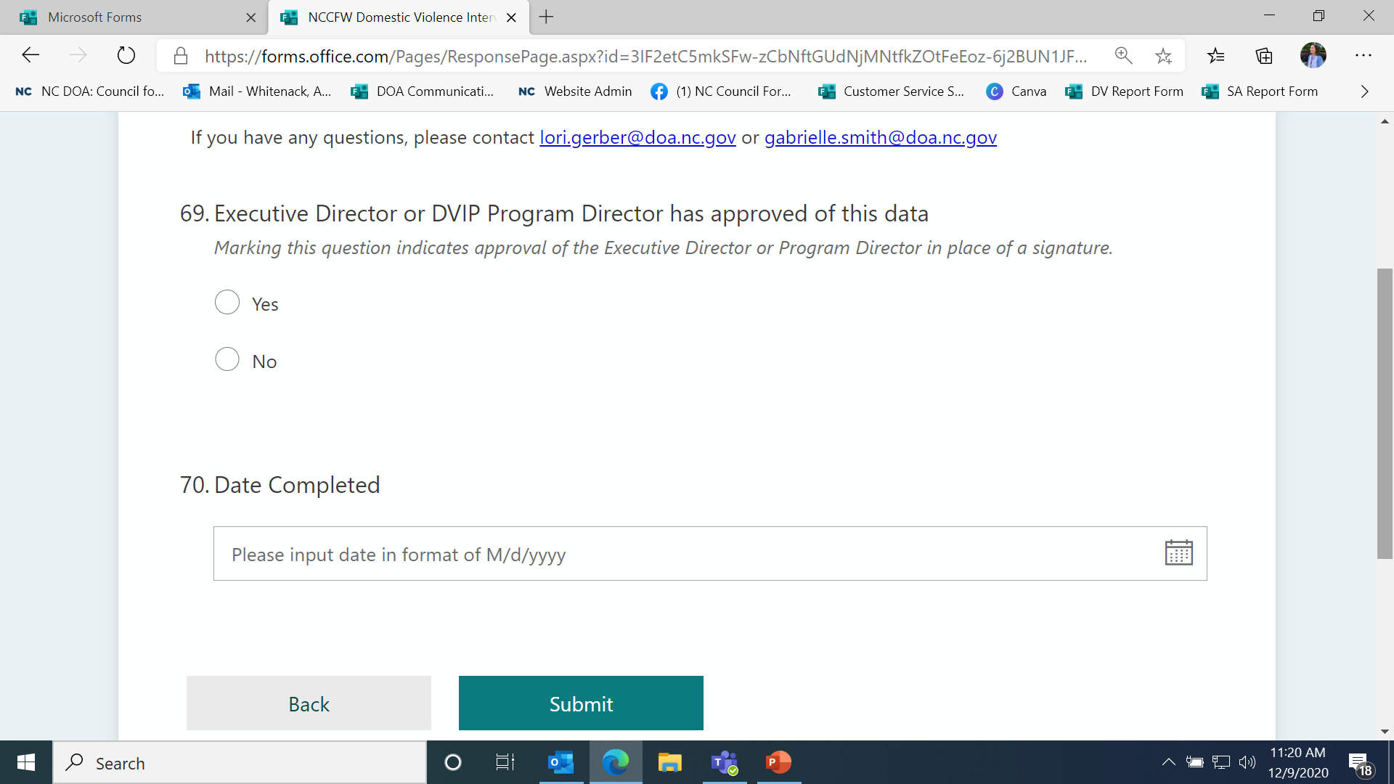
This section takes the place of a signature of your Executive Director or Program Director. Ensure that this data has been approved by the appropriate person.
This is also the last section. Click the “Back” button to review your answers and ensure they are accurate.

Slide 16
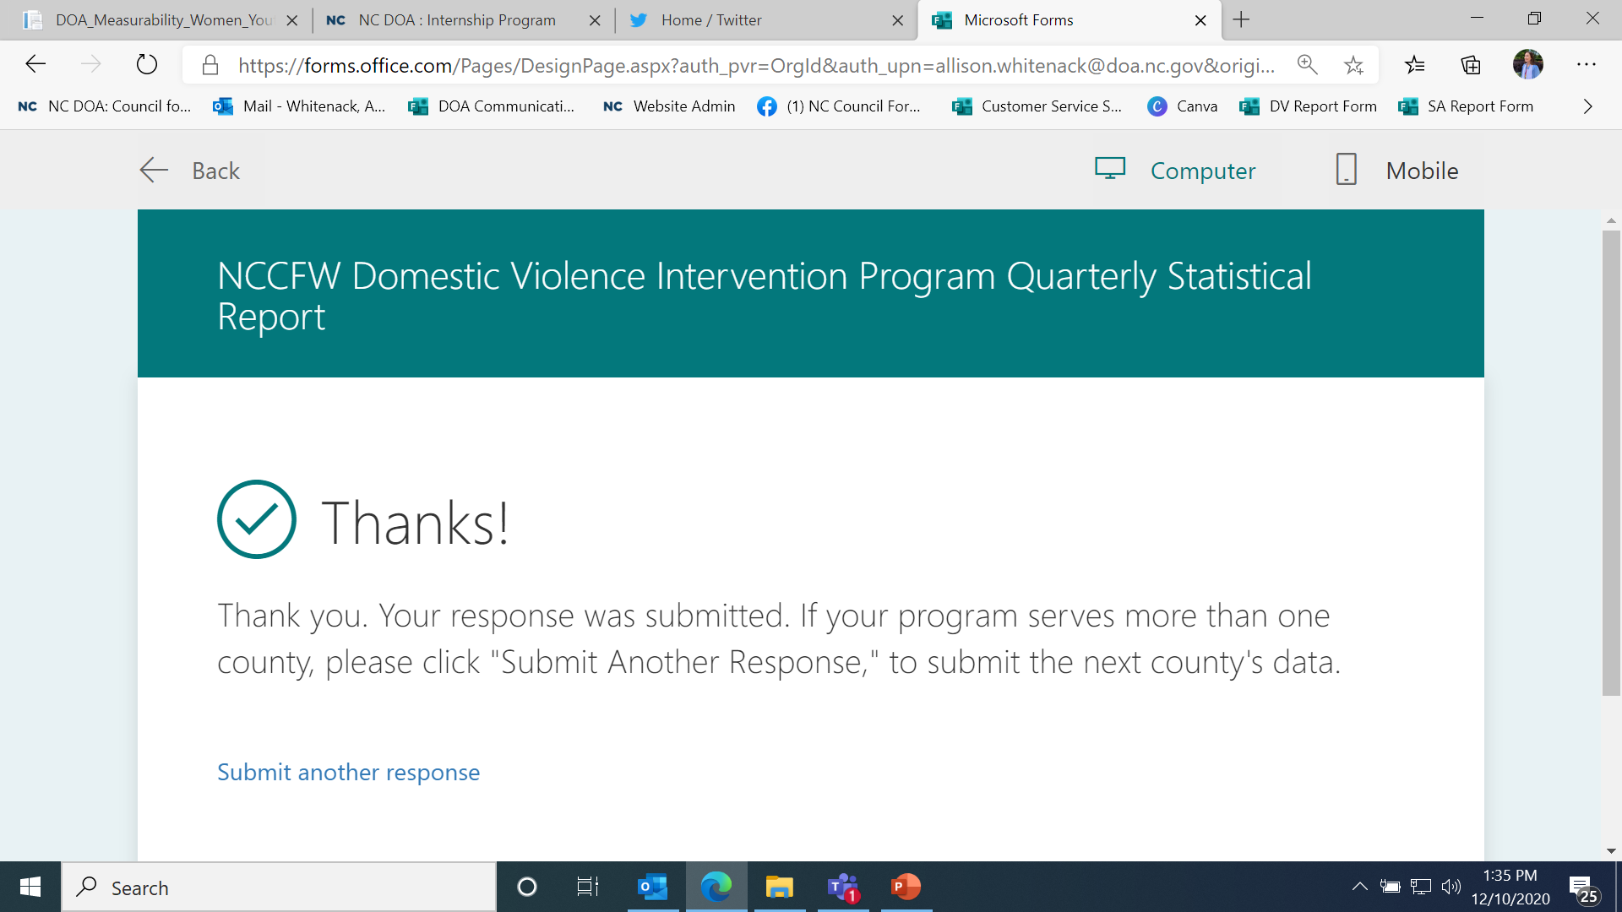
If your agency serves more than one county, you MUST submit separate reports for each county. Click “Submit another response” to do so.

